Slide 1
Department of Rehabilitation Voice Options Program

Slide 2
Housekeeping

Slide 3
Meeting Minutes

Slide 4
Voice Options Program: An Overview
What we do
Voice Options Providers
Voice Options Consumers
Data Collection

Slide 5
Voice Options Program Data
Total Consumers served: 728
Total Providers: 23
Counties Covered: 46
California Coverage: 92%

Slide 6
Consumer Demographic Data
Highlights:
Increased types of Disabilities served
Reaching more ethnically diverse consumers

Slide 7
Voice Options Monthly Report Review

Slide 8
Voice Options Program: The Impact
Consumers, families, and caregivers noticed:
Improved Mental/Emotional Wellbeing
Improved Self-worth
Greater Independence and Self-Advocacy

Slide 9
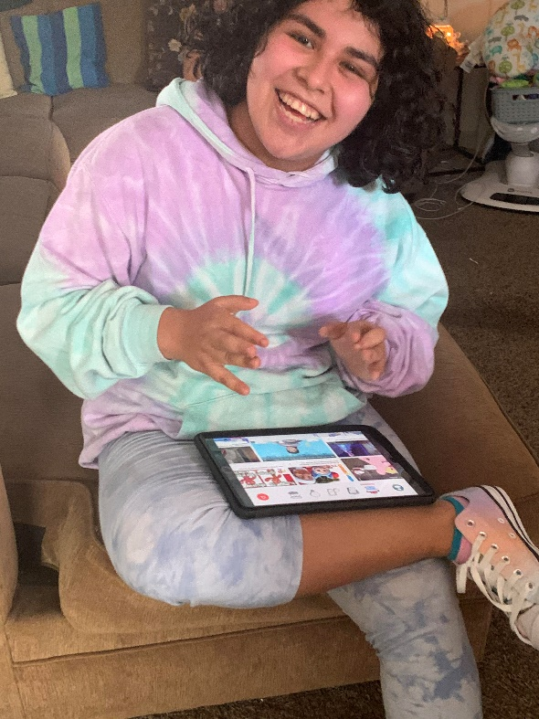
Highlights from Consumer Satisfaction Surveys
Notes:
Image Caption: A young woman smiling at the camera with her brand-new speech device and application in her lap (she just received her LTL device through the Voice Options Program!)

Slide 10
Voice Options Outreach
CPUC’s Deaf and Disabled Telecommunications Program (DDTP) Annual Marketing Plan
Email blasts/calls to various organizations and potential Providers
Provider Newsletters

Slide 11
Voice Options – Ever Adapting
Added Proloquo2Go
iPad Accessibility Assistance
Disaster Relief
Protocols for Consumers in Hospice/Palliative care

Slide 12
Voice Options – Moving Forward
More/Improved speech applications
Incorporate additional devices
iPad Maintenance/Application Upgrades
Additional Program Connections/Resources

Slide 13
Questions or Comments?

Slide 14
Thank you for your time!
For more information please contact:
VoiceOptions@dor.ca.gov
http://Dor.ca.gov/Home/VoiceOptions

