Slide 1
Setting Up & Using GoTalk NOW PLUS
Learn more about GoTalk NOW PLUS products at https://www.attainmentcompany.com/gotalk-now-plus
Notes:
We are proud to offer the Voice Options Training. This training is brought to you by the staff at Department of Rehabilitation, from CTEC, Communication Technology Education Center.
We will visit the Attainment website.
Because The Attainment Company is the manufacture of ‘Go Talk Now Plus’ You will find the most current information about ‘To Talk Now Plus, instructional support, video training and updated versions of the application.
Let’s get familiar with Attainment!!!
Here is the URL.
https://www.attainmentcompany.com/gotalk-now-plus

Slide 2
LEARNING OBJECTIVES
By the end of the training, you will be able to:
Identify individuals who would benefit from this app.
Create a Communication Book.
Navigate the Editor and Revise Page Payouts
Customize Buttons in the Communications Tabs
Create a phone script and listen in the player mode.

Slide 3
GoTalk NOW PLUS IN ACTION
Video 1: Go Talk Now Plus a Special Needs Child
https://youtu.be/Ue86-Ydw42w
Notes:
Go Talk NOW PLUS is awesome for its unlimited storage for books and pages, voices, templates AND backup. YOU CAN restore and share via Wi-Fi and AirDrop.
GoTalk Now is a customizable communication application. Where Communication books can be quickly created to meet your individual needs. Pages can be created with one, two, four, 16 or 25 buttons on a page. Visual scenes can also be created on the fly with its built in page editor.
Lets watch (2) short videos that demonstrates how the Go Talk NOW PLUS Application in action and how this helps a consumer with a speech and language disability.
Just a few of our FAVORITE FEATURES ARE:
Totally personalized
Start from a blank page
Ease of editing
Add or reduce buttons quickly
Access to video
Easy back-up and sharing of online templates
GoTalk NOW PLUS offers:
SymbolStix Library
Ready-Set- Communication Book- a transitional vocab from phrase-based to word-based communication (And Acapela text-to-speech English voices

Slide 4
CONSIDERATIONS FOR SELECTION
Someone who wants to develop their communication skills
Experience with mid-tech Augmentative and Alternative Communication (AAC)
Prefers videos, pictures, people and symbols
Someone who may require larger targets
Notes:
Some Nice Benefits that are included in ‘Go Talk Now Plus’ include:
A consistent layout of the icons that allows for better planning to learn the location of icons and icon sequences that represent words and phrases.
Vocabulary Builder allows you select a list of words you want to teach and only shows the icons for those words
Allows user to work with SymbolStix images

Slide 5
GETTING STARTED WITH GO TALK PLUS
AT the Home Screen
1. Communication Default Book
2. The Player
3. The Page Editor
4. Settings
5. Downloads
6. Help
Notes:
Getting Started
1. First Time users Communication book is title ‘Default Book’
2. The player is used for play the communication books that will
be created in the Page Editor
3. The Page Editor is used to add message locations to the page
and to modify text button appearance and adding actions.
4. Settings control the setting for the application
5. Download where you can obtain Core Words, Purchase Image
Libraries, Download Premade Communications Books for a
fee, obtain text to speech voice applications
Let’s review:
4

Slide 6
SETUP: CREATING A NEW COMMUNICATION BOOK
From the Home Screen:
1. Tap on the Communication Book title ‘Default Page’
2. Tap the arrow to the right to
duplicate the book
Rename for ex: ‘(‘Your Name’) Book
Press enter
Notes:
Creating a new Communication Book
Communication books can be created only from the First Page (Main options page). When opening the GoTalk NOW PLUS app, if a page opens, press and hold the home button for 7 seconds to enter the First Page.
(I ALWAYS SAY, HOLD IT UNTIL FRIDAY!)
First time user’s Communication Book title
Default Book.
Tap on the current Communication Book title at the bottom of the page
Tap the Plus icon at the top left corner
Type a title ( MY PHONE BOOK)
Press Create
View your new book, press Player

Slide 7
NAVIGATION: PAGE EDITOR
Home Screen
Player or Page Editor
Notes:
Let’s get to editing our new book See the next slide for how to.
FrPlayer Mode, slide three fingers down the screen, or hold the Home button down for 7 seconds
To edit your new book, press Page Editor
From the Home screen:
press Player to view your new book
To edit your new book, press Page Editor
While in Page Editor, tap the Home icon to return to the Home screen
While in player mode, swipe down with three fingers on the screen, or hold down the Home icon for 7 seconds
FAVORITE FEATURE IS EASE OF EDITING:
JUMP BETWEEN THE PAGE EDITOR AND THE PLAYER BY MAKING A 3 FINGER CIRLE!!!!!

Slide 8
STEPS TO EDIT A COMMUNICAITON BOOK
To edit your new book, press Page Editor
From the Home screen:
Select the Communication Book you want at bottom of page
Tap anywhere on the page to get back to main screen
Tap the ‘Page Editor’ button
Select the ‘Pages’ button and select the page to edit
6. Tap a ‘blank’ button or a button to edit
7. Edit button as needed with options presented
Notes:
Looking at slide 7 to see the buttons and then follow these instructions

Slide 9
NAVIGATION
Page Editor
Player
Notes:
Icon images represent various menus and switching between Page Editor and Player Mode can be tricky at first.
A favorite feature is ease of editing: USE A THREE FINGER SWIPE TO GO DIRECTLY SWITCH BETWEEEN PLAY FROM PAGE EDITORE MODES
Or holding the home button for 7 seconds to navigate between the editor and player

Slide 10
CREATE CORE VOCABULARY WORDS TO RESPOND
Core Vocabulary
Notes:
Core Vocabular Words are the most common words that you might use.
Use Core Vocabulary for your most common words. The Table in the Page Editor may also show as ‘Quick Buttons’ . Add up to four high frequency words or phrases. The same 4 messages are available on all pages of your communication book.
Let’s demonstrate how to create Core Vocabulary Word list
Let’s create a ‘Core Vocabulary Words’ or ‘Quick Buttons’ and show how these button will show up in the editor and the player.

Slide 11
How to update Core Vocabulary Words to Respond:
1. From the Home Screen, Select your Communication Book
2. Tap on the Page Editor ‘!’ button called Core Vocabulary or ‘Quick Buttons’
3. Tap on the “Tap to Add Button’
4. Tap on the ‘A Button Text’
5. Add your text and Picture
Notes:
Core Vocabular Words are the most common words that you might use.
Use Core Vocabulary for your most common words. The Table in the Page Editor may also show as ‘Quick Buttons’ . Add up to four high frequency words or phrases. The same 4 messages are available on all pages of your communication book.
Let’s demonstrate how to create Core Vocabulary Word list
Let’s create a ‘Core Vocabulary Words’ or ‘Quick Buttons’ and show how these button will show up in the editor and the player.

Slide 12
CUSTOMIZE PAGE LAYOUTS
Notes:
Editing Page Layout Options:
You can quickly change the number of buttons on a communication page by
cicking on the Page Options button to control the Page. Select 1, 2, 4, 9, 16, 25, or 36 to change the number of message locations (buttons) per page.
Let’s try an exerciese to demonstate this tecinque works.

Slide 13
HOW TO SELECT PAGE LAYOUT OPTIONS
From te page layout screen
1. Tap the Page Options icon
2. Select Number of Buttons on page:
1, 2, 4, 9, 16, 25, or 36 message
locations
3. Make sure ‘Enabled’ is on
4. Tap anywere on the page to exit
Notes:
NEED MORE BUTTON LOCATIONS?
Editing Page Layout Options:
You can quickly change the number of buttons on a page by
Clicking on the Page Options button to control the appearance of a Communication Page. Select 1, 2, 4, 9, 16, 25, or 36 to change the number of message locations (buttons) per page.
Displays a defined grid layout.

Slide 14
CREATING NEW BUTTONS
Go to the Page Editor
2. Select the ‘Page’ to
add a button
3. Press or Tap “Tap to Add
Button’
4. Modify the button as
needed
Notes:
Tap on a blank button that reads Tap to Add Button. Any button with a dotted line border doesn’t exist in Player Mode and will show up as blank space. This is useful for individuals with visual impairments.
Creating Message Locations (buttons)
Create a message location to add vocabulary to a page. The new Message Location will have a white background, black border, and Editing buttons will be above and below the Message Location for changing appearance and features.
We are going to create a button that introduces us on the phone
Press Tap to Add Button – My name is
Add Text
Add Photo or image

Slide 15
EDIT BUTTON COLORS
1. Click on the Button Text
2. Select Background Color
3. Select color of choice
4. Tap anywhere on button to
exit
5. Follow same process for
border colors
Notes:
Here is where you are able to modify button to your specific needs by adding colors, border and background for emphasis.
Let’s demonstrate how to add color to a button
Tap on Add Button
2. Tap on ‘A Button Text’
3. Tap on Button Text in Blue near top of the dialog box
4. Enter your text
5. Select font and font style
6. Select you text color by tapping on your color selection
7. Tap anywhere on the page to exit the dialog box
8. Select done

Slide 16
CUSTOMIZE A BUTTON TEXT SIZE & POSITION
In the Editor do the following:
Select Page to Edit
Tap on the Message Location Button.
Select Button Text
4. Select Font Size
5. Select Font Style
6. Hold Finger of Text move
and drop to position
Notes:
When you edit a button all of the editing settings are right there!
Let’s edit the text and button to introduce yourself.
Editing a Button Text
The words Button Text appear as a placeholder for a label.
1. Select Button Text tab to change the message label
2. Tap Text to add or remove text to the Message Location
3. Type in the text entry field
Editing Button Text
Tap on Button Text or double-tap the text of an opened Message Location to use text adjustment settings.
1. To change text Size, drag the slider control along 32-200 size range. You can also change the text size by pinching or stretching your fingers on the text on the Message Location (button)
2. Move the text by holding and dragging the text with one finger.
3. Select Font to change the text style
4. Scroll with a finger to Set Font
5. tap Button Text at the top left, to return to the Button Text tab
6. Use Swatches or Picker tab to select a color
7. To exit the Button Text tab, click anywhere outside of that tab or tap Button Text
By default, the Button Label will function as speech if an action of the button is not edited. (Text-to-Speech default setting)

Slide 17
ADDING BUTTON IMAGES
From Page Editor, tap on message location
Tap Add Image
Select image source
Select image
Tap outside the Add Image tab
Tap Done
Notes:
When you edit a button all of the editing settings are right there!
Adding an Image to a Button
Images can help a person who may have difficulty reading words, enhance meaning for words, and allow for personal expression on buttons.
1. Tap Add Image button to place an image on the message location
2. Choose one of the four source options: GoTalk Image Library (over 4,000 images), Internet Search, Take Photo (from iPad), and From Photo Library
3. When using GoTalk Image Library type scroll through the categories or type in the text field.
NOTE: FUN STUFF! Multiple images can be added in Message Location.
1. Pinch, stretch, fingers on the image to enlarge, and reduce its size
2. Twist fingers to rotate an image
3. Finger-drag the image on the Message Location to relocate the image
4. Double-tap or hold down on the image to enter the Edit Image tab
Edit Image settings Crop, or Delete image, reposition an image, crop an image, bring to font, or save to Camera Roll. Exit Edit Image tab by tapping anywhere on the screen outside the tab area.

Slide 18
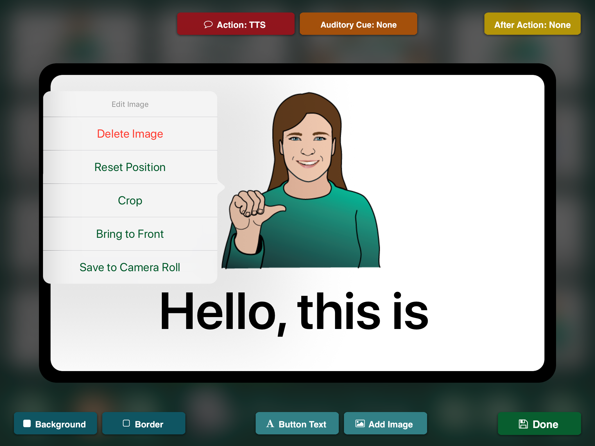
EDIT BUTTON IMAGES
1 From Page Editor, tap on
message location
1. Tap the Pages Icon at bottom
of page
2. Select the Book to edit the
image
3. Tap on the message location
4. The edit image menu will appear
5. Make an edit selection
6. Tap anywhere on page to exit.
Notes:
When you edit a button all of the editing settings are right there!
Adding an Image to a Button
Images can help a person who may have difficulty reading words, enhance meaning for words, and allow for personal expression on buttons.
1. Tap Add Image button to place an image on the message location
2. Choose one of the four source options: GoTalk Image Library (over 4,000 images), Internet Search, Take Photo (from iPad), and From Photo Library
3. When using GoTalk Image Library type scroll through the categories or type in the text field.
NOTE: FUN STUFF! Multiple images can be added in Message Location.
1. Pinch, stretch, fingers on the image to enlarge, and reduce its size
2. Twist fingers to rotate an image
3. Finger-drag the image on the Message Location to relocate the image
4. Double-tap or hold down on the image to enter the Edit Image tab
Edit Image settings Crop, or Delete image, reposition an image, crop an image, bring to font, or save to Camera Roll. Exit Edit Image tab by tapping anywhere on the screen outside the tab area.

Slide 19
ADDING PAGE LABEL AND IMAGE
For a Page Label, tap the label area of the editing screen
Type the title in the text entry field
Tap Set Font to edit text size.
For a page icon, Tap Icon
Select from Internet Search, Take Photo, or From Photo Library
Tap Done
Notes:
Lets name the page “ Phone Chat” it will be the first page in our Book
From the CTEC GoTalk Now Quick Reference guide let’s follow these steps
Adding a Page Label / Image
A Page Label appears at the bottom of the Communication Page. By default a page number is assigned. Assign Page Labels to all pages to easily identify pages when creating an Action: Jump.
1. Tap the label area of the editing screen
2. Type the title in the text entry field
3. Tap Set Font to edit text size.
4. Let’s hold off on adding images for now :) select DONE
Page icons function as a visual aid for memory, help a person who may have difficulty reading words, enhance meaning for words, and allow for personal expression.
Adding a Page Label / Image
A Page Label appears at the bottom of the Communication Page. By default a page number is assigned. Assign Page Labels to all pages to easily identify pages when creating an Action: Jump.
Tap the label area of the editing screen
Type the title in the text entry field
Tap Set Font to edit text size.
Select Add Image to place an image by the page title.
Choose on of the four image source options: GoTalk Image Library, Internet Search, Take Photo, From Photo Library.
‘

Slide 20
EDIT BUTTON ACTIONS
1. Click on the Text Button
2. In Top of screen tap on Text-to-Speech
3. Select Recorded Audio
4. Select Jump to Page
5. Select Media Player
6. Select Video
7. Launch URL
Notes:
If you don’t change anything on the actions menu the button will simply read the label.
There are a lot of things you can do when button is selected.
Adding Actions to a Message Location
Use the Action button in the top left corner of the screen to add media to a Message Location. Options are to add Recorded Audio, Text-to-Speech, Jump to Page, Media Player, Video, URL.
1. Add Recorded Audio by pressing Recorded Audio, Start Recording, Stop Recording, then tap anywhere outside the Action tab.
2. Text-To-Speech is the default setting for a button’s action. Without assigning an action, Button Labels will be spoken when in Player Mode. To have a different message than the Button Label, select Action (Action: TTS), type new message, tap on the Action Button to close the tab.
In addition, you can store songs, play videos, access websites, play YouTube videos
3. Media Player is used to select a song from iTunes song list.
4. Video is used to select a video from the iPad’s camera roll or from a Dropbox account. The button will function as a video player button.
5. URL is used to assign a website to a button. It will open in the iPad web browser (must be connected to Wi-Fi).
6. Jump To Page will eliminate a speech option and redirect to a new page. Press Change, select page in the Jump To Tab.

Slide 21
SOUND SETTINGS: CHANGING THE VOICE
From Page Editor, tap on a blank or existing button
Tap Action: TTS
Tap Voice, then select a Voice
Tap Preview to hear the voice
Tap anywhere on the screen to exit Action: TTS menu
Notes:
You can easily change the voice of the speech device. Changing the voice on one button, changes the voice for the entire vocabulary.
Let’s demonstrate how to add a voice to a text button
Tap on a blank or existing button
Tap Action: TTS
Tap Voice, then select a Voice
Tap Preview to hear the voice
Tap anywhere on the screen to exit Action: TTS menu

Slide 22
Design: Whole Messages or Complete Sentences for a Button
A single button quickly states your whole message
Notes:
Describe the use of storing whole messages
A phone script or communication script can be used to provide quick
And responsive answers to questions and the scripts have numerous
Applications can be easily modified to adjust to the user needs.
Use Example to run in Player in action
Get Default book
Go to Player
Select Karl’s Home Page
This show how some sentences can be combined on a button

Slide 23
COMMUNICATION OVER ANY SPEAKERPHONE
Notes:
DISTANCE COMMUNICATION The most simple way to use an AAC device with a telephone is to listen and speak over a speakerphone. Some apps also have features to support email, text messaging, and social media.
(Confirm with Kevin)
Unfortunately the limitations of the IPAD hardware and iOS do not allow the ability to make a voice call and use the speaking app simultaneously. Some Speech Generating devices do have this capability.
NOTE: CTAP, the California Telephone Access Program has a variety of adapted speaker phones that will assist you in “picking-up” dialing and “hanging up the phone. These phones may be helpful to you and information can be found at www.californiaphones.org .

Slide 24
IN-PERSON VS. DISTANCE COMMUNICATION
Notes:
COMMUNICATING
IN PERSON & AT A DISTANCE
When using your Voice Options Tablets individuals have the opportunity to speak with individuals in a variety of settings. This may be the first time they have the opportunity to talk on the phone independently, or carry on a conversation with an audible voice!
WHEN COMMUNICATING WITH YOU… Some individuals with Complex Communication Needs (CCN) have no discernable verbal speech. Others may use a little bit of verbal speech that can be understood if it is accompanied by signs, facial expressions, gestures, have no/low tech communication systems. AAC Systems are a tool to be considered for anyone with CCN.
Many individuals with CCN depend upon a combination of multiple strategies or use of for Total Communication. These communications strategies include the communication partner seeing them, or hearing their device , or verbal speech.
Consider the communication setting.
YOU CAN HEAR ME & SEE ME. Being together in the same room gives individuals the ability to use non verbal strategies and their device or verbal speech
YOU CAN ONLY HEAR ME. If I want to speak on the phone, or if I need to speak to an individual who is in the other room I can not rely on my nonverbal communication strategies.
YOU CAN ONLY SEE WHAT I WRITE. I may pass you a note to you, send you an email, or make a post on social media.

Slide 25
YOU CAN HEAR ME & SEE ME
Signs
Facial expressions
Gestures
Vocalizations
Context
Communication device
Notes:
Discuss the information on the slide
Signs could be a low tech communication method to communicate
And a Communication device would be low tech or mid tech

Slide 26
YOU CAN ONLY HEAR ME
Signs
Facial expressions
Gestures
Vocalizations
Context
Communication device
Notes:
Here is photos that shows some of the challenges a consumer faces with Distance Communication.

Slide 27
GoTalk NOW PLUS MAKING A PHONE CALL
Video 2: Making a phone call
https://youtu.be/UFSVNAcm9Lk
Notes:
Go Talk NOW PLUS is awesome for its unlimited storage for books and pages, voices, templates backing up, restoring and sharing communications template through Wifi, Google Drive, Airdrop or the computer.
GoTalk Now is a customizable communication app. Where Communication books can be quickly created to meet your individual needs. Pages can be created with one, two, four, 16 or 25 buttons on a page. Visual scenes can also be created on the fly with its built in page editor.
Lets watch a videos that demonstrates how the Go Talk NOW PLUS Application in action and how this helps a consumer with a speech and language disability.
After Video: Just a few of our FAVORITE FEATURES ARE:
Totally personalized
Start from a blank page
Ease of editing
Add or reduce buttons quickly
Access to video
Easy back-up and sharing of online templates
GoTalk NOW PLUS offers:
SymbolStix Library
Ready-Set- Communication Book- a transitional vocab from phrase-based to word-based communication
And Acapela text-to-speech English voices
Attainments introduction to Go Talk NOW version 4 found at: https://www.youtube.com/watch?v=Ry65FtqspXk

Slide 28
PURPOSE OF A PHONE SCRIPT
Speed up communication
Get your main point across accurately
Control the conversation
Repair breakdowns
Notes:
What is a phone script
Describe what a phone script is..
PHONE SCRIPTS helps you..
SPEED UP COMMUNICATION
GET YOUR POINT ACROSS ACCURATELY
CONTROL THE CONVERSATION
REPAIR BREAKDOWN
Let’s talk more about a phone script and the contents of a phone script…
(next slide)

Slide 29
DOWNLOADING PAGE TEMPLATES
Select Pages button
Tap plus
Select Online Gallery
Choose by Category in the drag bar to search all templates
Tap search to look up a specific topic.
Select the page to download
Tap Download
Tap Add to Communication Book
Notes:
Go Talk NOW PLUS is entirely customizable and individuals or a support person can create or edit Communication Templates. Some communication templates are available to download for free on the Online Gallery
Let’s do a practice to obtain a communication book from the Gallery
( to get there, just go to last communication page until you see ‘+’. Next Click on the ‘+” to see the online gallery.
Search by Category or press Search to type specific words.
Adding, Downloading Page Templates
COMMUNICATION
TECHNOLOGY
EDUCATION
CENTER
1. Select Pages button 2. Tap plus
3. Select Online Gallery
4. Choose by Category in the drag bar to search all Templates
5. Tap Search to look up a specific topic, select the page to download, tap Download, tap Add to Communication Book.
Downloaded Templates show what is already downloaded to the device
My Templates show what Communication book have been saved as a Template from the device. Import From Another Book, allows you to choose a page from another book stored on the device.

Slide 30
CONTENTS OF A PHONE SCRIPT
Manage the call
Greetings & Closings
Repair breakdowns
Share the main message
Notes:
PHONE SCRIPTS:
Our page should include vocabulary that is intended
Manage the call
Should be used for greetings & closings
To Repair breakdowns in a conversation
To Share the main message
Let’s work together to create a
1. phone scrip page – will create togeher
2. phone chat page see below
2
The phone Chat will be added from the ‘Online Gallery by search for CTEC
By using the Seach Button and search on CTEC, then use the Voice Options Phone Chat and add to your communication book

Slide 31
HOW TO COMPLETE A PHONE SCRIPT AND PHONE CHAT PAGE
Notes:
FILL IN THE REST OF YOUR BUTTONS!
LETS SEE HOW MANY YOU CAN MAKE IN 10 MINUTES. You can copy my example or put what you would say when you are on the phone.
Remember to consider what vocabulary needs to be added in order to:
Manage the call
Greetings & Closings
Repair breakdowns
Share the main message
1.

Slide 32
LET’S COMPLETE A SCRIPT PAGE
Go to the Editor
Select the ‘Pages’ button to navigate to the last page in a communication book
Tap tFrom the Home screen, tap Page Editor
Tap the orange plus icon at the bottom right of the page to go directly to the New Page Menu
Select Add Blank Button Page
he orange plus icon at the bottom right of the page to go On-line Gallery
Search ‘CTEC’
Select Voice Options Phone
Add to Communications Book
Modify template to fit your needs
Notes:
Remember to consider what vocabulary needs to be added in order to:
Manage the call
Greetings & Closings
Repair breakdowns
Share the main message
Phone Script
1.

Slide 33
LET’S COMPLETE A CHAT PAGE
Go to the Editor
Select the ‘Pages’ button to navigate to the last page in a communication book
Tap From the Home screen, tap Page Editor
Tap the orange plus icon at the bottom right of the page to go directly to the New Page Menu
Select Add Blank Button Page
Select the orange plus icon at the bottom right of the page to go On-line Gallery
Search ‘CTEC’ Phone Sample
8. Add to Communication Book
9. Modify template as needed
Notes:
Remember to consider what vocabulary needs to be added in order to:
Manage the call
Greetings & Closings
Repair breakdowns
Share the main message
Phone Script
1.

Slide 34
ADD PAGES TO A COMMUNICATIONS BOOK
From the Home screen, tap Page Editor
Tap the orange plus icon at the bottom right of the page to go directly to the New Page Menu
Select Add Blank Button Page
Notes:
ADD MORE PAGES/CONTENT
You can do the following:
Import from another book
2. Duplicate a page
3. Use the Page Wizard
4. Add the Keyboard Page- where you can type your message
5. Add a Blank Screen
6. Add Blank Button Page
7. Download template
8. Review Templates created
9. Use On-line Gallery for additional searches
Adding Button Pages
1. From the Home screen, tap Page Editor
Tap the orange plus icon at the bottom right of the page to go directly to the New Page Menu
Or tap the Page Menu icon
Tap the plus icon
Select Add Blank Button Page
For generative spellers you can add a keyboard page.

Slide 35
AFTER ACTION: JUMP TO PAGE
When the icon uses text-to-speech, select:
After Action: jump
Jump to Specific page
then select desired page
Notes:
We can swipe between pages or we can link our pages to help MANAGE CONVERSATIONS WITH RATE ENHANCEMENT FEATURES. While many apps come with buttons programmed to link to different pages, GoTalk NOW PLUS offers a blank slate to allow complete personalization for managing conversations.
Here is how to...
JUMP TO A SPECIFIC PAGE:
Because we want our buttons to speak, “I FEEL” and then jump to the specific page (FEELINGS), we will use the AFTER ACTION button on the top right
When the icon uses text-to-speech, select:
After action: jump
Jump to Specific page
then set desired page
Adding Actions after Message
When a button has a Recorded Audio or Text-to-Speech the button can have a second action.
1. Select After Action button (After Action: None) on the top right of the screen. Options are Do Nothing, Go to Next Page, Go Back, or Jump to Specific Page.
1. To create an action to a different page other than the page before (Go Back) and after it (Go to Next Page), select Jump to Specific Page
2. Press Set
3. Select a page in the Jump To tab
4. Tap on the After Action tab to exit those settings.
Jump to Specific Page functions as a book navigation button.

Slide 36
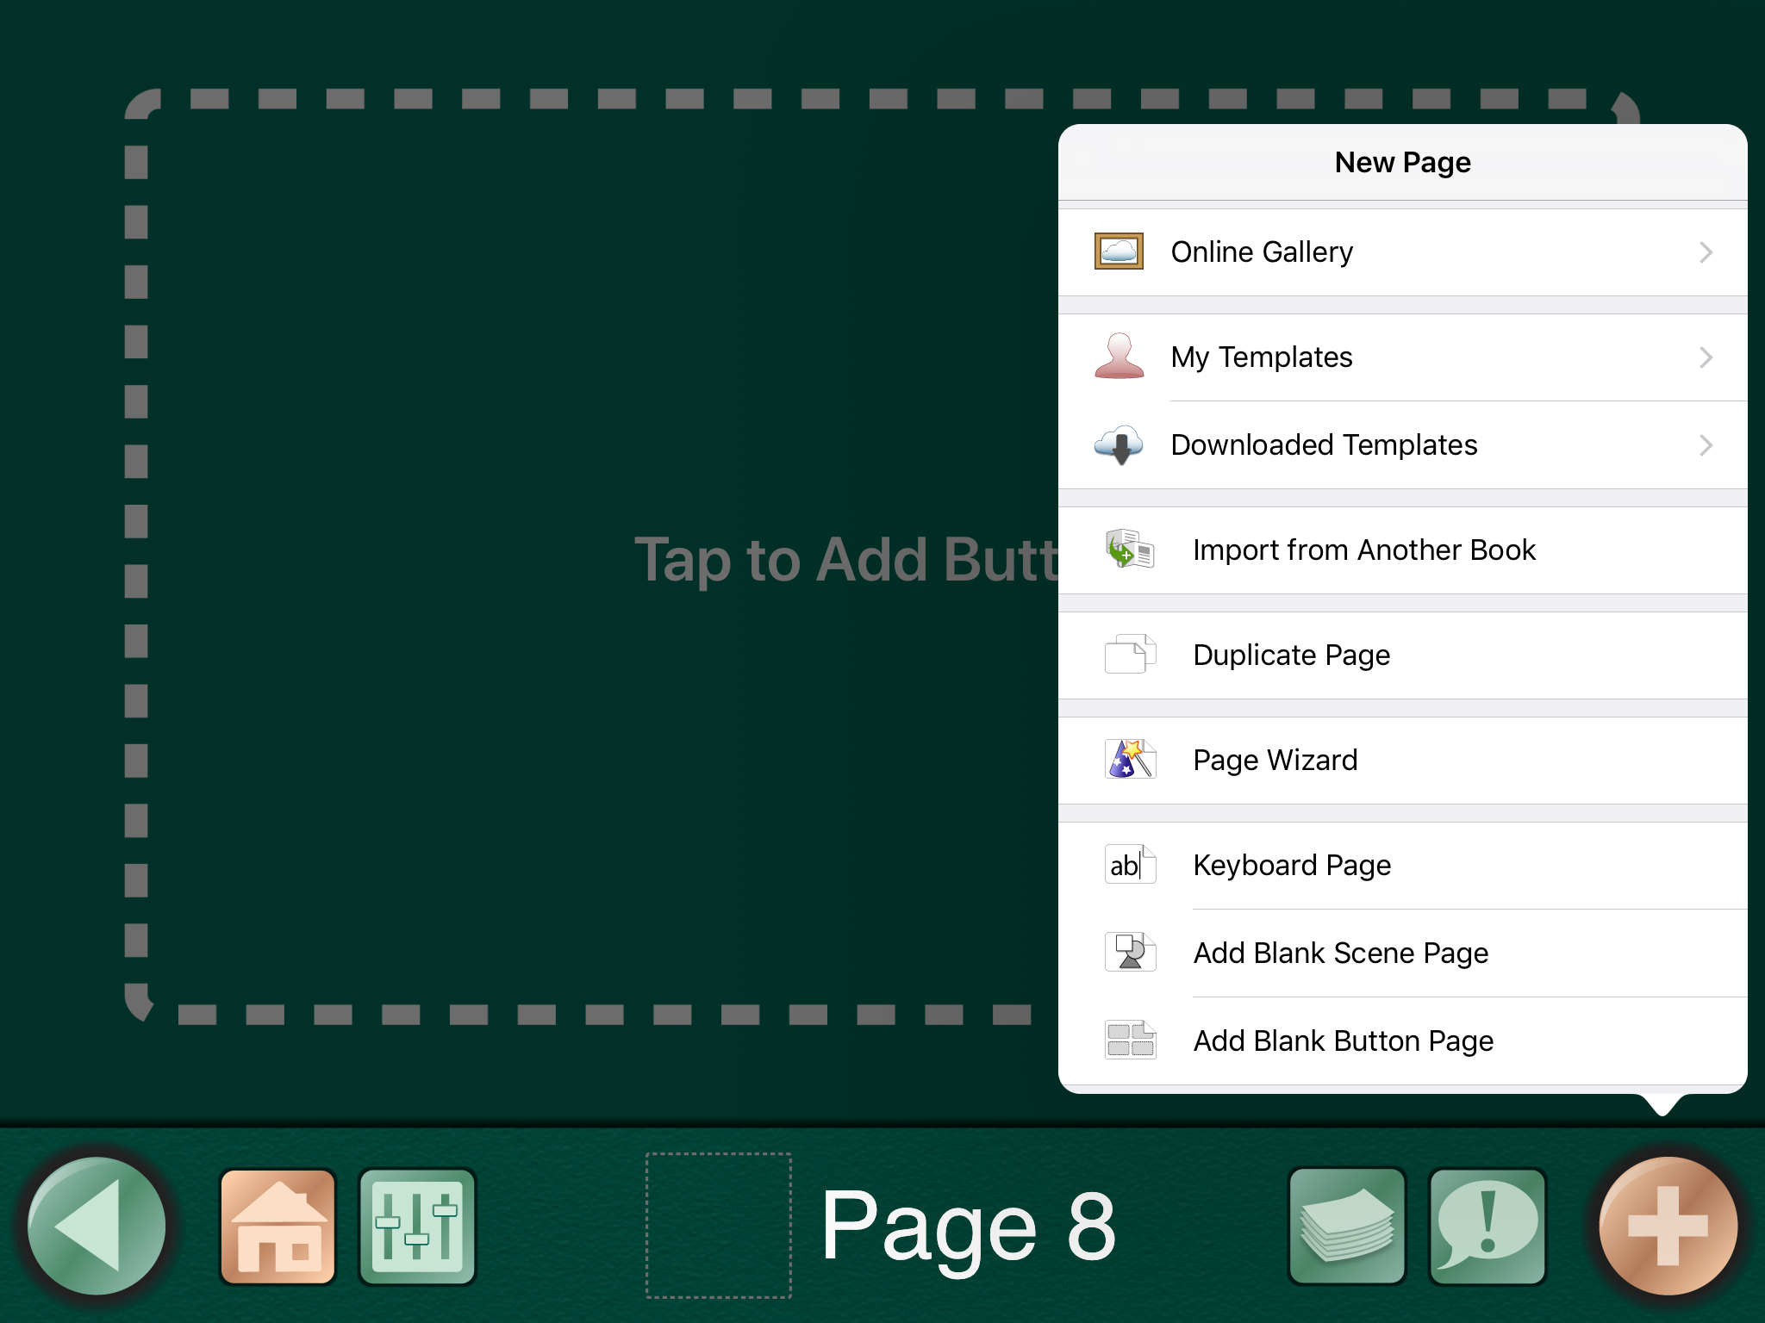
PAGE WIZARD- ADD A PAGE LIKE A WIZARD!
Notes:
Use the page Wizard to create a page with any button layout. The Wizard will fill in images if Add Images From Library is set to GoTalk Image Library before typing in the button text below in the Buttons Section. If no image match was found the button will show text only.
Since GoTalk NOW PLUS is entirely customizable, think what is the BIG PICTURE/MAIN THEME for the page you create. For individuals who may benefit from a large vocabulary think what categories should you add and later link to separate pages. IE: greetings/closings, different main messages, (PHONE RIDE, PHONE APPOINTMENT, OR CONCERT)

Slide 37
GETTING ORGANIZED: COPY, PASTE, SWAP
Use Core Vocabulary
First Rearrange Buttons
And Organize Pages
Notes:
Button Layout Options: Copy, Paste, Swap, Remove
Message Locations can be copied to other available buttons on a (current or different) Communication Page.
To Copy a button:
Tap-Hold (Press) down on a Message Location,
Tap Copy
Tap-Hold on an available button location
Select Paste.
To Swap button locations:
Tap-Hold (Press) down on a button, press swap, tap a different Message Location to switch places.
To Remove a button:
Tap-Hold (Press) down on a button
Tap Delete to clear the Message Location
To Hide a button:
Tap-Hold (Press) down on a button
Select Disable to hide the button from being seen in Player mode without permanently deleting the button from Page Editor mode.
Organizing Pages
The Pages button on the bottom right of the screen is used to add, rearrange, and delete pages.
From the Home screen, tap Page Editor
Tap the Page Menu icon
Tap Edit
To rearrange pages:
Tap Edit
Tap-Hold down on a page
drag to change the page order
To delete pages
tap the red (minus) deletion button
tap Delete
Adding Core Vocabulary
Allows you to add up to four Message Location buttons available throughout a Communication book.
Press the Core Vocabulary button on the bottom right of the screen.
Select an available Message Location
Edit the button as needed: text, image, action, and colors.
Copy, Paste, Delete, and Disable functions still apply.
Swap function is not accessible in Core Vocabulary.
REPAIR BREAKDOWNS USING CORE VOCABULARY LIKE: hold on a second, please wait while I speak my message….

Slide 38
BACKING UP TO DROPBOX
From the menu page, tap the name of the book.
Tap the Share icon
Tap Back Up/Restore
Select Via DropBox
Tap Create
Notes:
Let’s discuss what a drop box is.
A Dropbox is an online storage site service offering up to 2GB of free storage space. Use your computer to sign up and create a user account a dropbox.com. Once an account exists, download the free Dropbox app to your iPad.
Start at the Home screen.
Tap the book to open the list of Communication Books that are on your iPad.
Tap the Share icon for the book to be backed up and select Back Up/Restore.
The questions “Computer or Dropbox?” will appear. Select via Dropbox to start the backup process.
If this is the first time using Dropbox with GoTalkNow, tap Link Dropbox Account and provide your Dropbox account information.
When finished, tap Sign in and Link and repeat step 2 (future backups will not require the login information again). Then continue with step 4.
Tap Back Up to Dropbox from the pop-up window.
If this is the first backup to be added to your Dropbox folder, a pop-up window will appear asking you to name the backup. The existing name can be kept or changed.
Tap the Create button continue the backup process

Slide 39
BACKING UP: SHARING PAGES
From the Home screen tap Page Editor
Select Pages Menu button
Tap the plus icon
Select My Templates
Select Create
Complete information
Select pages to be included
Tap the cloud icon to share (select private or public)
Notes:
Here is the process to back and share communications pages:
To Create and Upload a Page TemplateC
Select My Templates
Select Create
Complete information
Set pages to be included
Tap the cloud icon to share (select private or public)

Slide 40
QUESTIONS??
Visit the Attainment website for the most recent training videos and technical support articles
Notes:
For product support or any questions, please contact: info@attainmentcompany.com
1-800-327-4269
Access GoTalk NOW PLUS website product information and updates at
https://www.attainmentcompany.com/gotalk-now-plus

