Slide 1
CALIFORNIA YOUTH
LEADERSHIP FORUM
FOR STUDENTS WITH DISABILITIES (YLF)

Slide 2
THE YLF EXPERIENCE

Slide 3
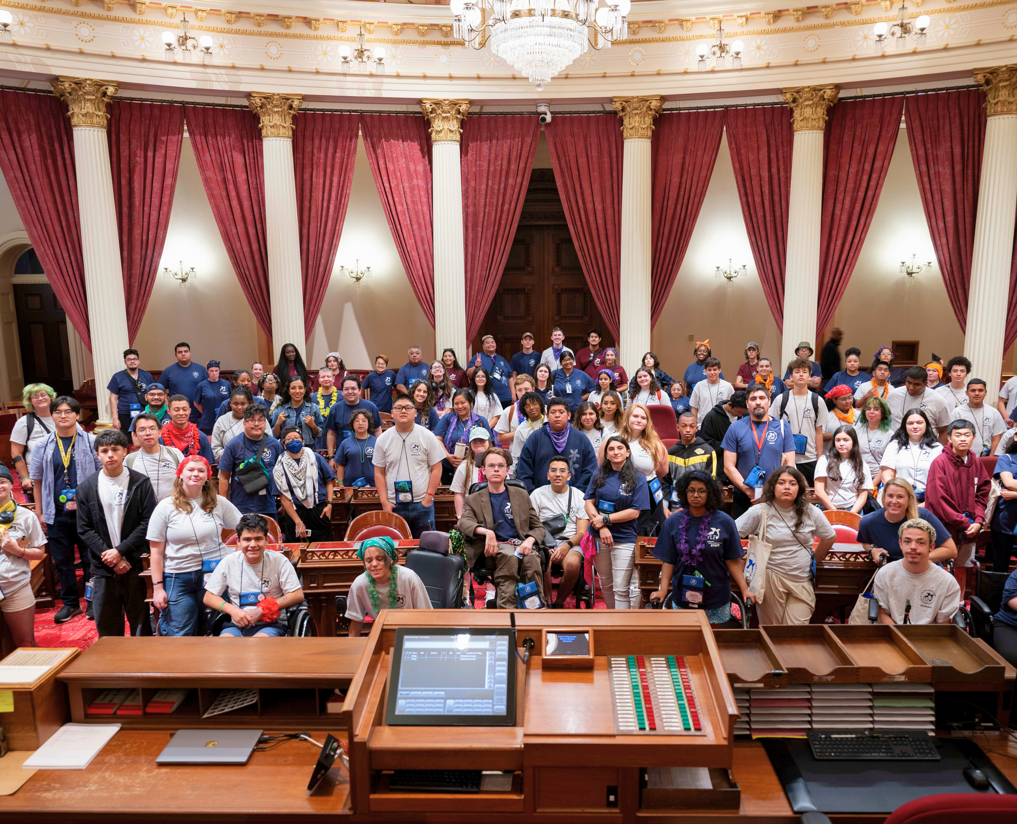
YLF 2024 OUTCOMES
For the first time since 2019, YLF was held fully in-person in 2024! YLF had received over 150 delegate applications for YLF 2024 and selected 60 students to participate in this year’s program! Students selected had spanned over 20 counties, a variety of disabilities and ages! This year we saw our largest growth in areas related to disability pride, disability history, resources and services, and self-advocacy.
“Now that I have attended YLF, I will challenge myself to find my limits. I will work hard to do things more independently and/or to get accommodations instead of just asking somebody to do something for me.”
-Rachel, Junior, Los Angeles County

Slide 4
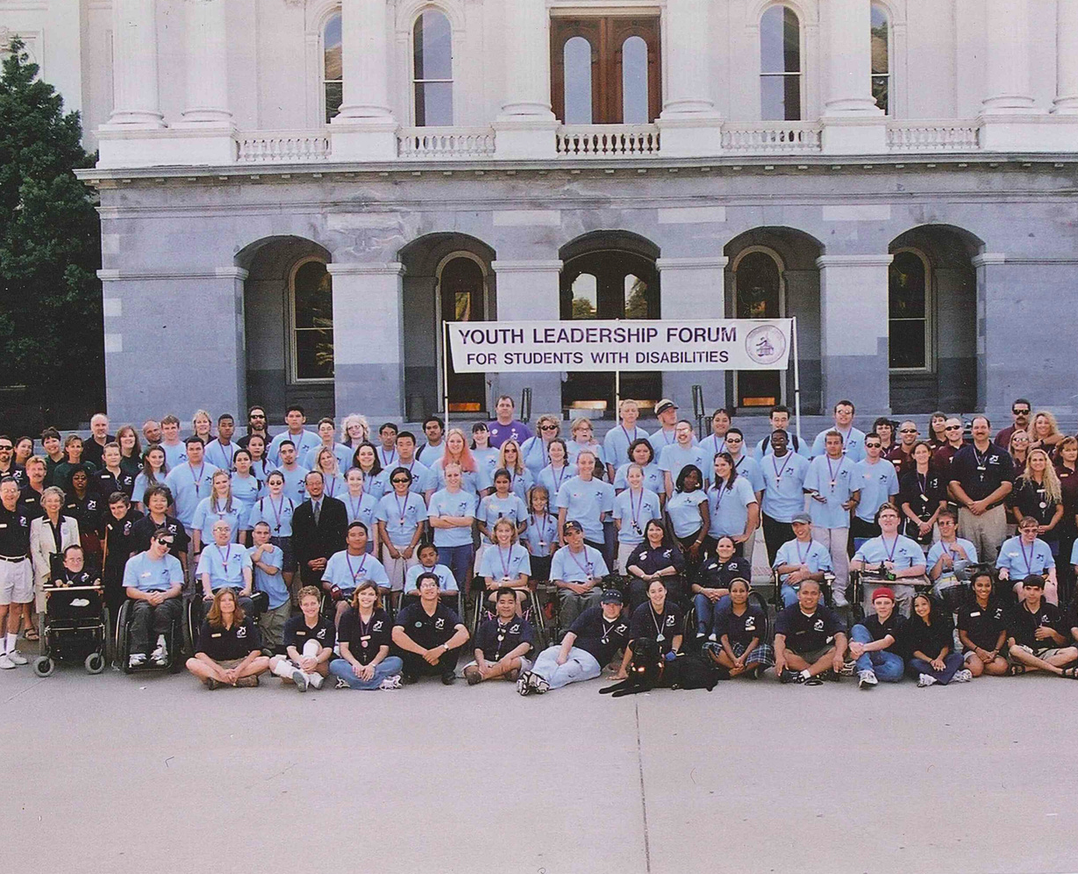
YLF BACKGROUND
First established in 1992 by the Governor’s Committee on Employment of Disabled Persons, which is known known as the California Commitee on Employment of People with Disabilities (CCEPD)
Since 1992 YLF has over 1500 Alumni who have successfully moved forward into higher education, gained employment, developed as local, state and national leaders and are living independently in their communities.

Slide 5
WHAT IS YLF?
Weeklong residential self-advocacy and leadership conference for high school students with disabilities who are currently sophomores, juniors, or seniors
During the week, YLF delegates will -
Build Advocacy and Leadership Skills in a Peer Setting
Meet State Policy Makers and Other Professionals with Disabilities
Design a personal leadership plan
Make lifelong friendships and create a community of support they can rely on for years to come

Slide 6
OUR GOALS
APPRECIATE
UNDERSTAND
BELIEIVE
IMPACT
Delegates will develop an appreciation for our Disabled Ancestors by learning about disability history including landmark legislation and experiences of people with disabilities
Delegates will develop an understanding of the present by exploring basic principles of leadership development and begin by building tools for self-advocacy and independence
Delegates will develop a belief in their individual future’s success by learning about services and programs to make their goals attainable, and creating a leadership plan to achieve them
Delegates will develop a community of support and mentors to not only support their personal goals, but to set goals that will impact the larger disability community and future lives of people with disabilities.

Slide 7
WHO IS YLF FOR?
YLF is a cross-disability program. We strive to have diverse representation from all types of disability, counties, communities, backgrounds, and lived experiences.
The only requirements to apply are California residency, in high school, at least a sophomore, and identify as a student with a disability.
YLF encourages students who have leadership experience, potentially through involvement in community or extra-curricular activities.

Slide 8
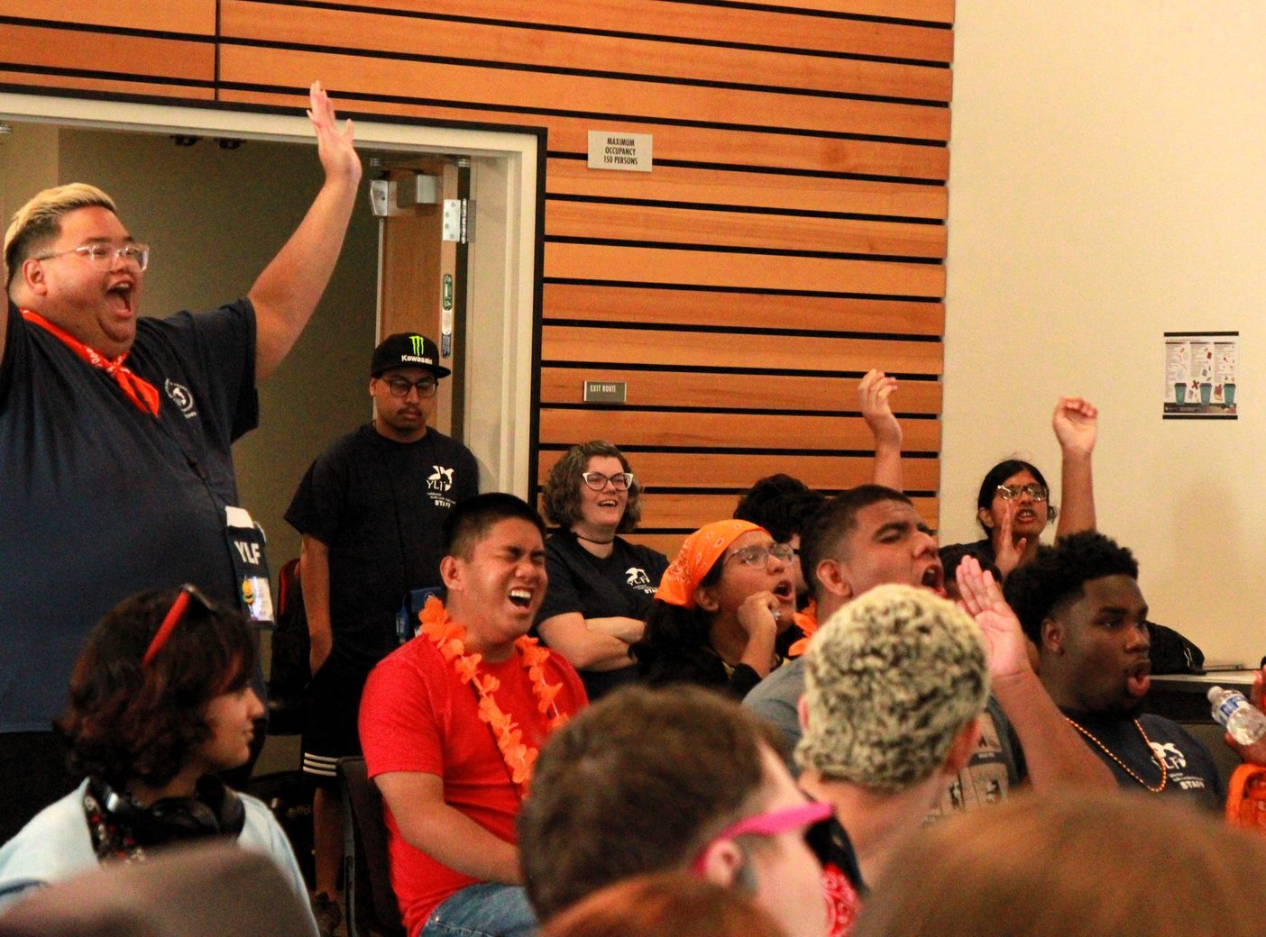
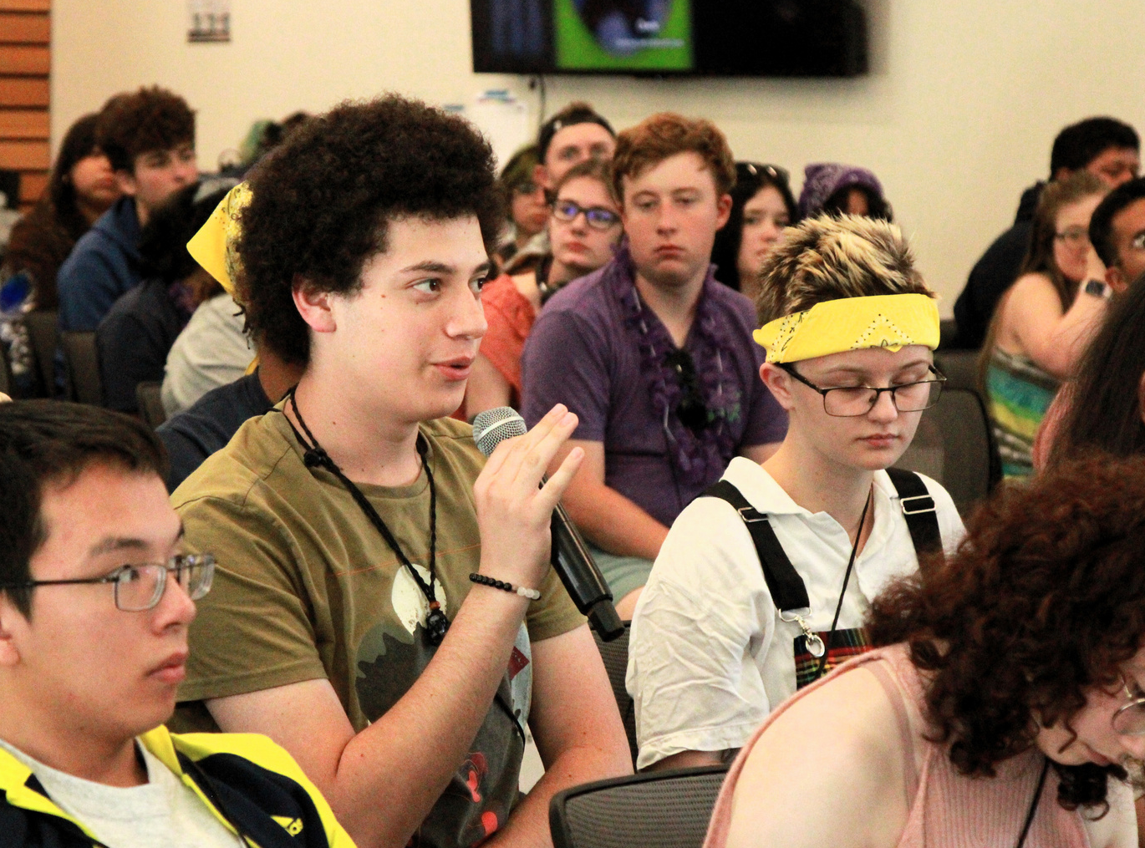
WHAT HAPPENS AT YLF?
During the week YLF Delegates will participate in various workshops and panels on topics related to employment, education, and independent living.
Breakout sessions are where delegates will get the opportunity to further explore these topics through activities and discussions as well as create their own goals and leadership plan for independence.

Slide 9
WHAT HAPPENS AFTER YLF?
YLF continues leadership development by hosting workshops, regional events, and community opportunities with our alumni network.
We encourage alumni to return to YLF and serve as mentoring staff for future YLF delegates. This is a great opportunity to build work experience and boost resumes.
There is also a national network of YLFs that host events bringing together alumni from across the country.

Slide 10
HEAR FROM OUR YLF ALUMNI

Slide 11
CONNECT WITH YLF
Stay connected and up to date with YLF Activities and Alumni by following us on
Facebook - www.facebook.com/official.ca.ylf
Instagram - @calylf
YouTube - @CalYLF
Or visit our website
www.dor.ca.gov/home/ylf
Email Us - ylf@dor.ca.gov
Call Us - (855) 894-3436

