Slide 1
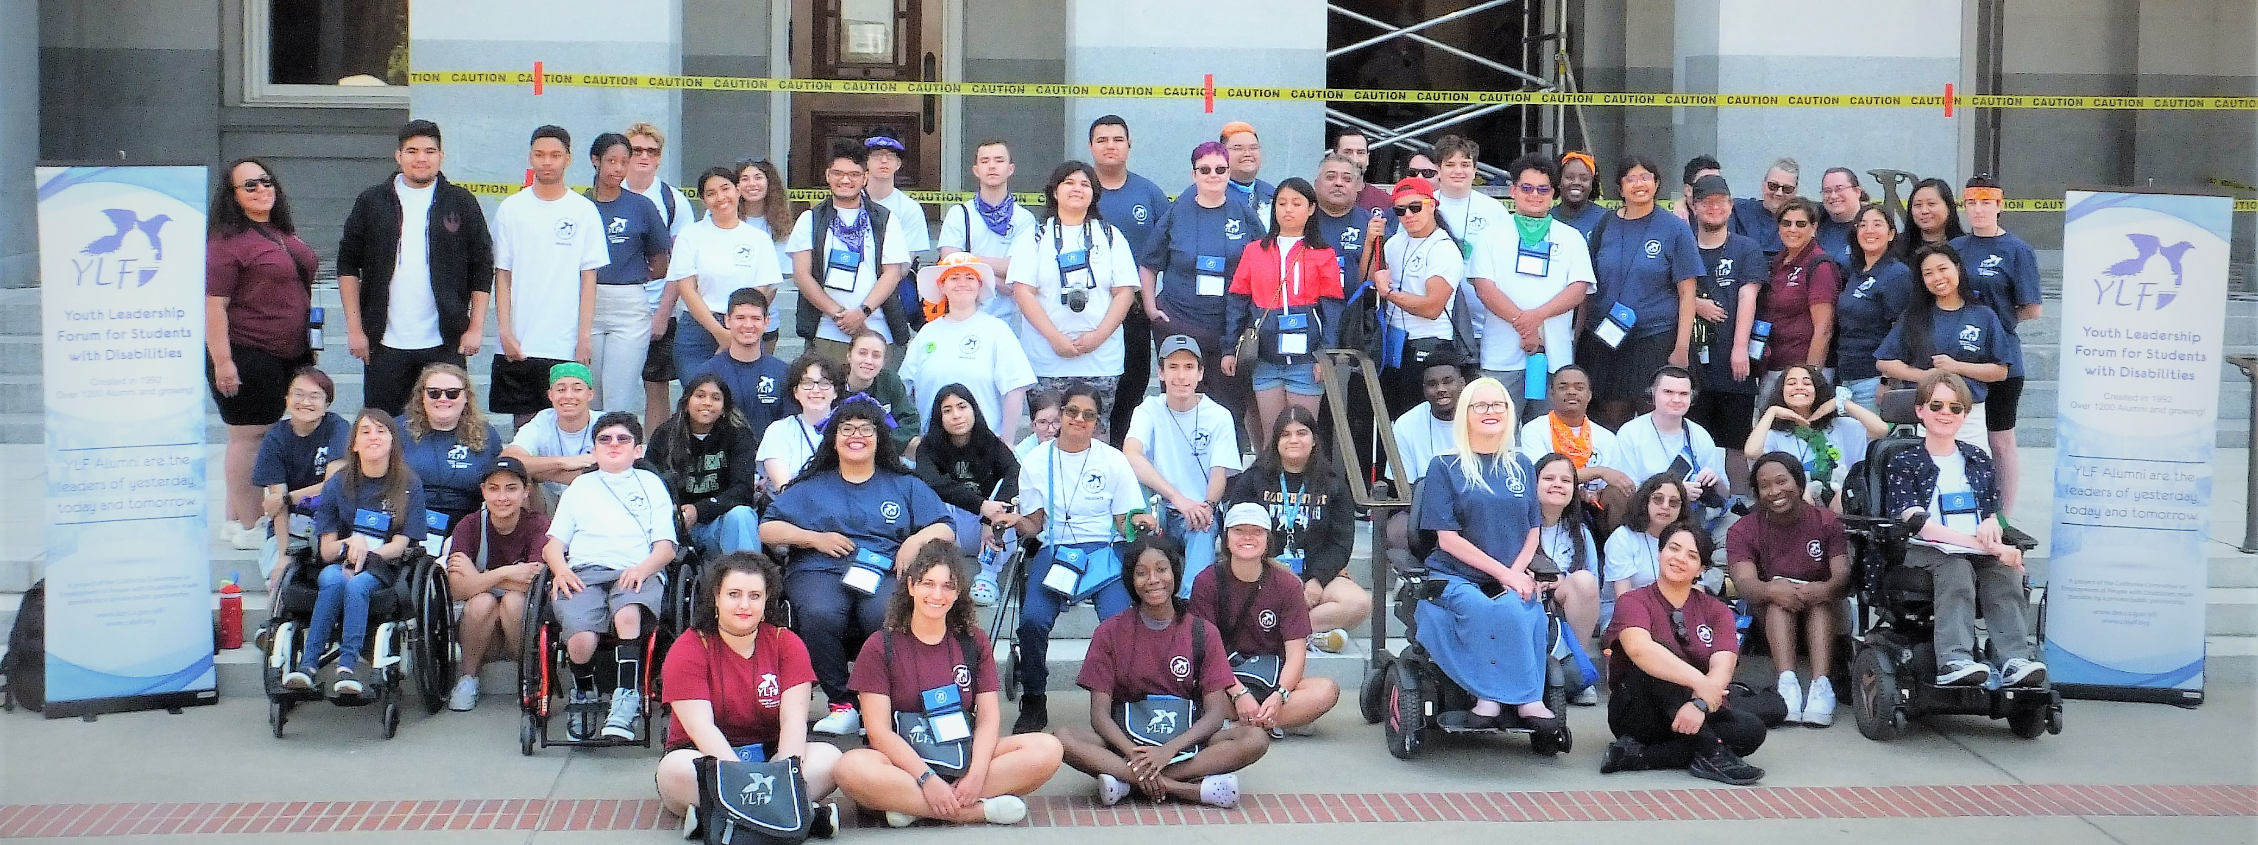
California Youth Leadership forum for students with disabilities (Ylf)

Slide 2
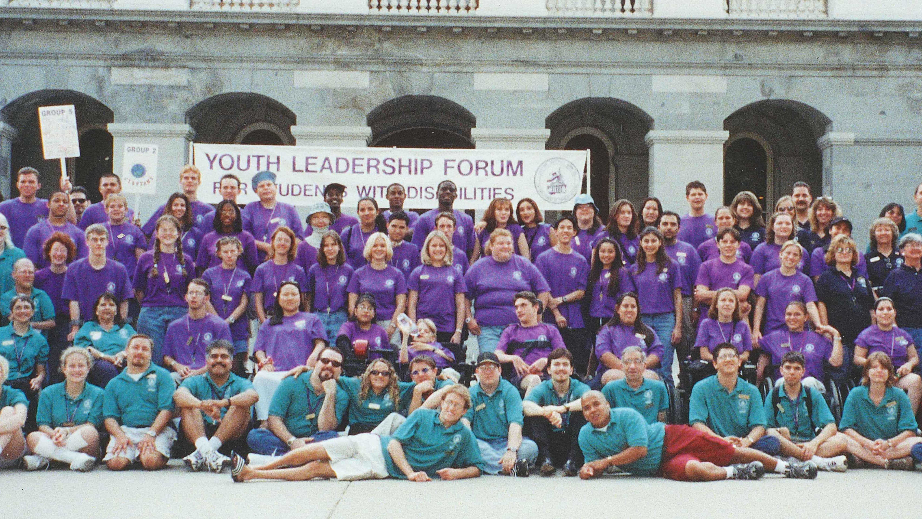
YLF Background and Legacy
YLF was first established in 1992 by the Governor’s Committee on Employment of Disabled Persons, which is now known as the California Committee on Employment of People with Disabilities (CCEPD)
California YLF’s success has led to a national YLF association and YLFs hosted in over 30 states and Puerto Rico
Since 1992 YLF has over 1500 YLF Alumni who have successfully moved forward into higher education, gained employment, developed as local, state and national leaders and are living independently in their communities

Slide 3
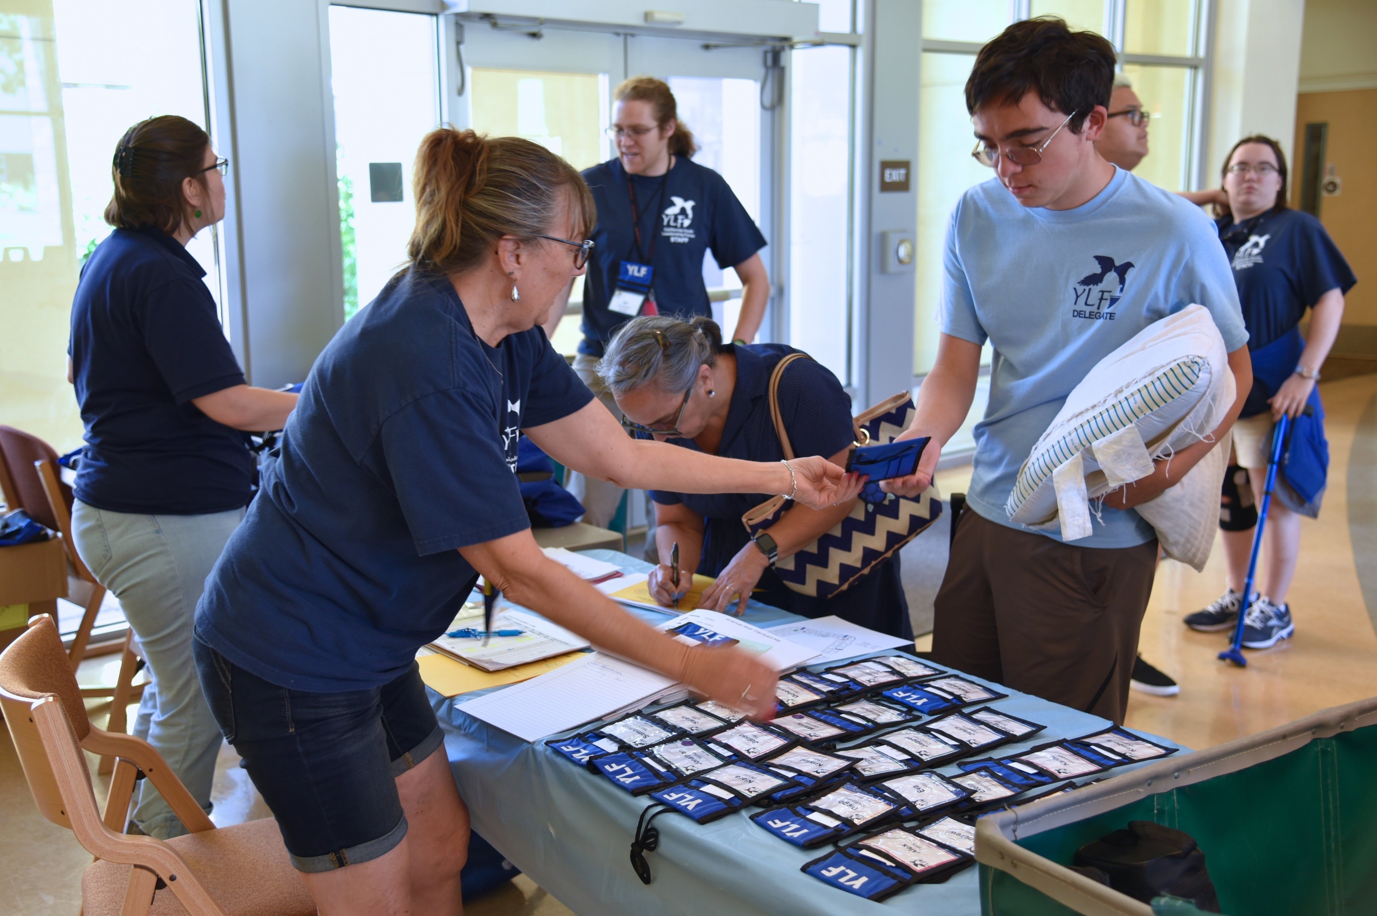
What is YLF?
Weeklong residential self-advocacy and leadership program for high school students with disabilities who are currently sophomores, juniors, or seniors
During the week, YLF delegates will –
Meet other students with disabilities from across California
Live on a college campus
Hear from teens and young adults who have transitioned out of high school and are exploring higher education, employment and independent living
Network with local, state and national leaders in the disability community

Slide 4
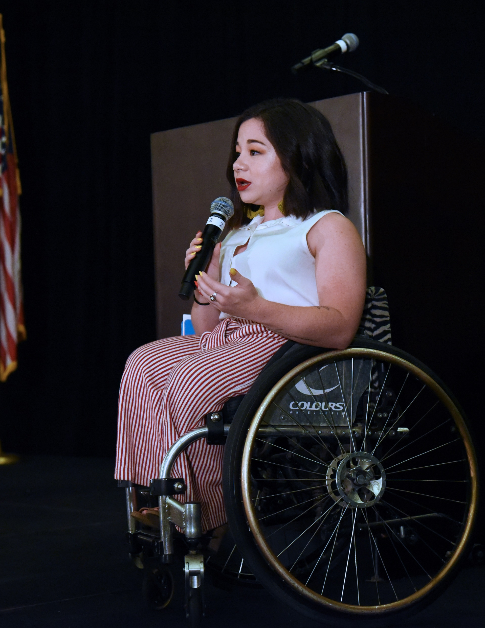
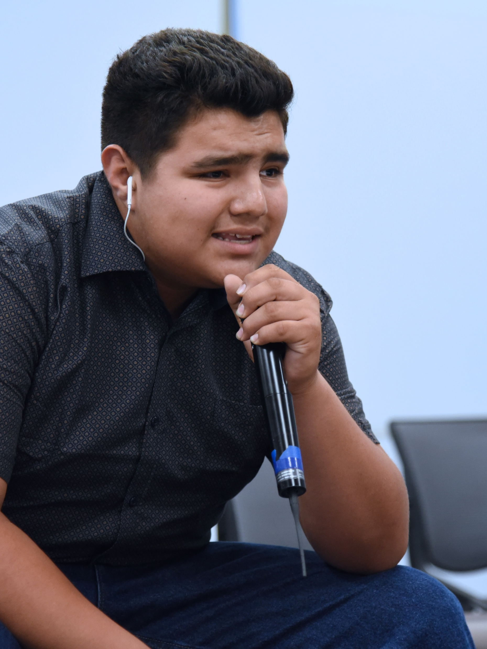
Who is best suited for YLF?
YLF is a cross-disability program, which prides itself on being made up of students with varying types of disabilities. The only requirement to apply is that you are a high school student with a disability.
YLF encourages students who have leadership potential, involvement in community or extra-curricular activities to apply to the program.
YLF is completely funded through a public and private partnership to ensure delegates can participate at no cost. YLF covers all travel costs, meals, reasonable accommodations including but not limited to ASL Interpreting, text captioning, personal care needs, durable medical equipment, incidental expenses, and assistive technology.

Slide 5
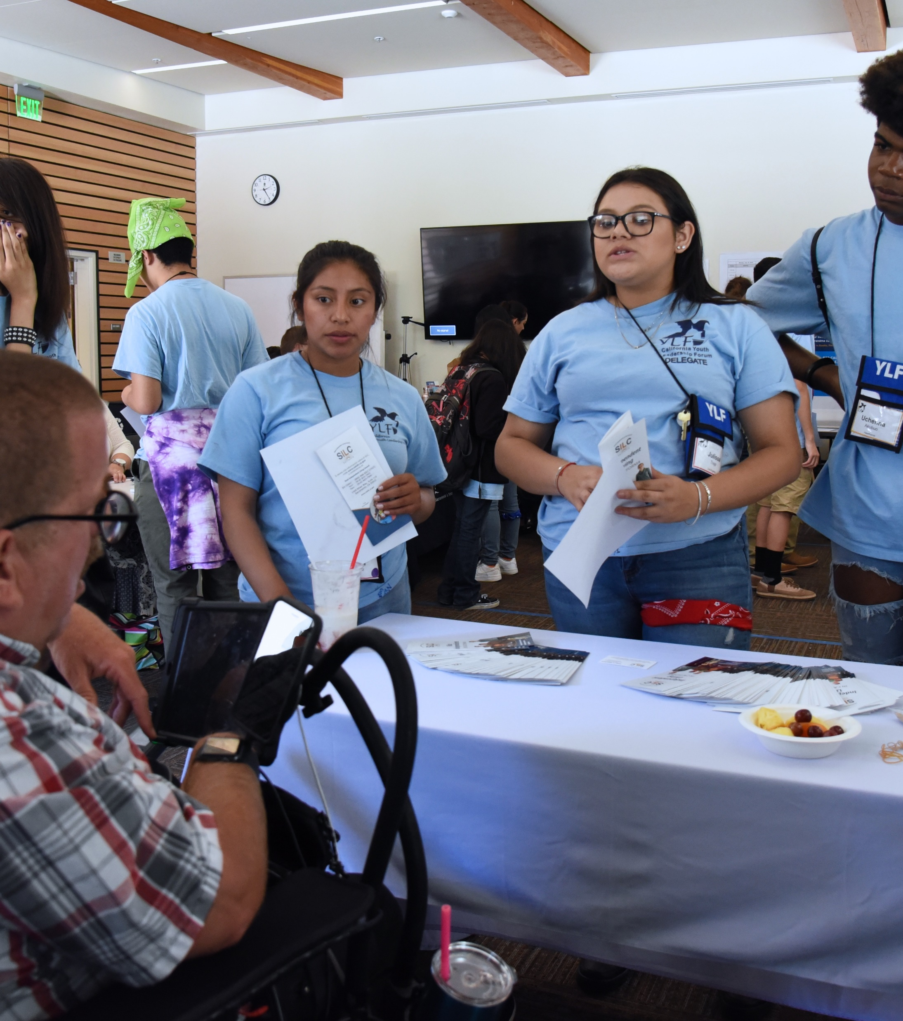
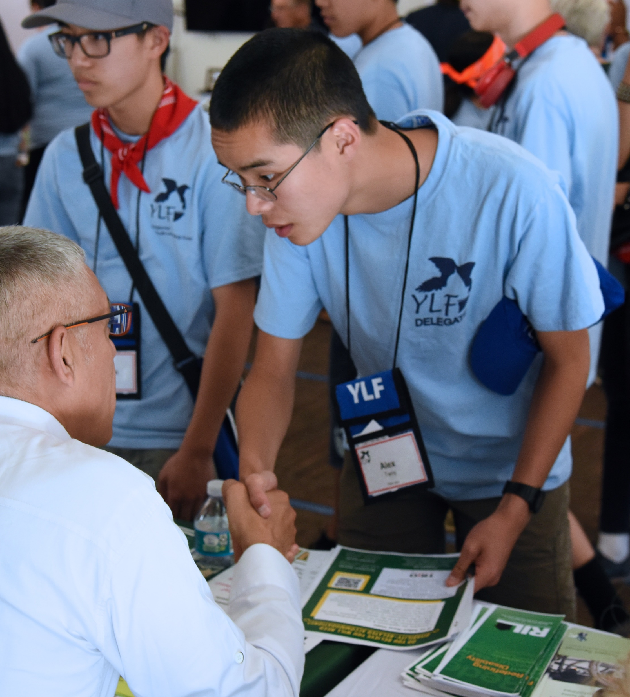
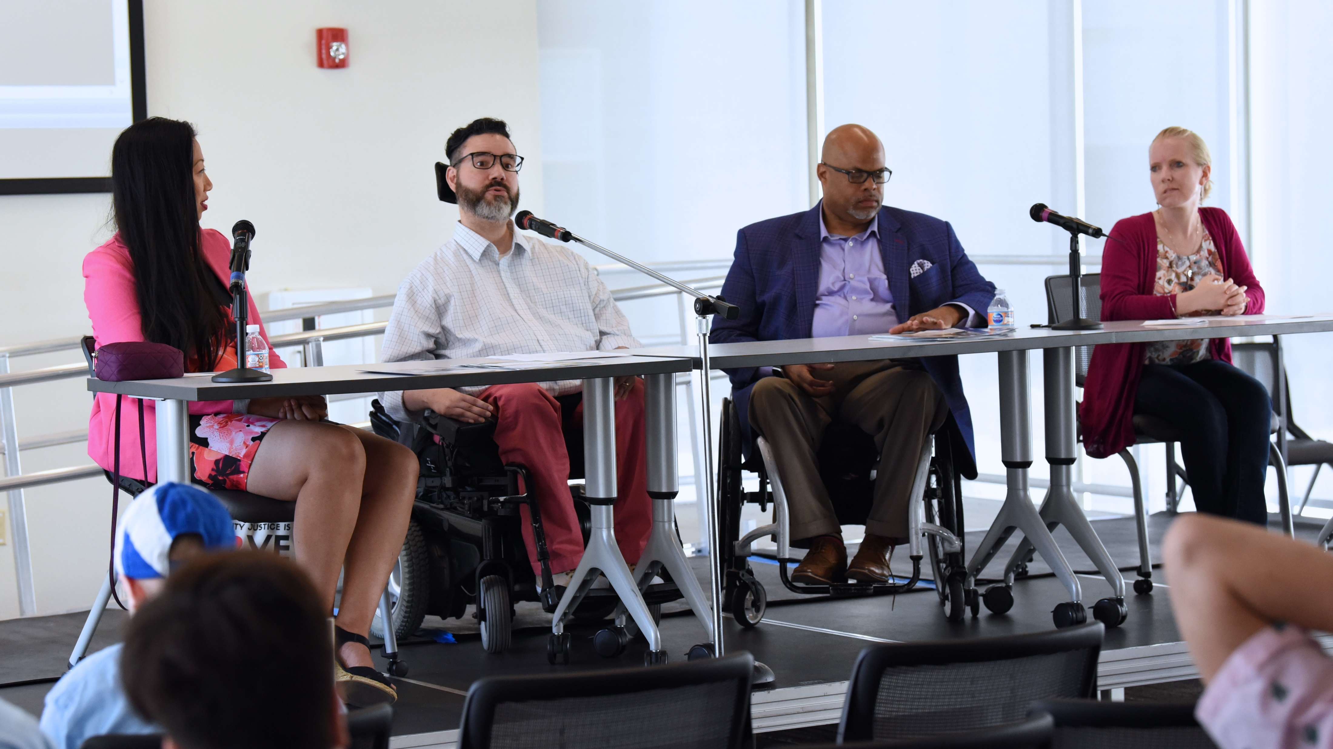
What Happens at ylf?
Each day of the program has a daily theme; sessions and activities are built around this theme. Themes include –
Our Disability Community, Culture and History: The Story of Us
Finding Resources to Reach our Goals
Discovering our Talents
Reaching our Potential
Engaging in our Communities
Leading On
Delegates have the opportunity to build a “Personal Goals and Leadership Plan” to use as a guide as they transition out of high school and into the next chapter of their lives.

Slide 6
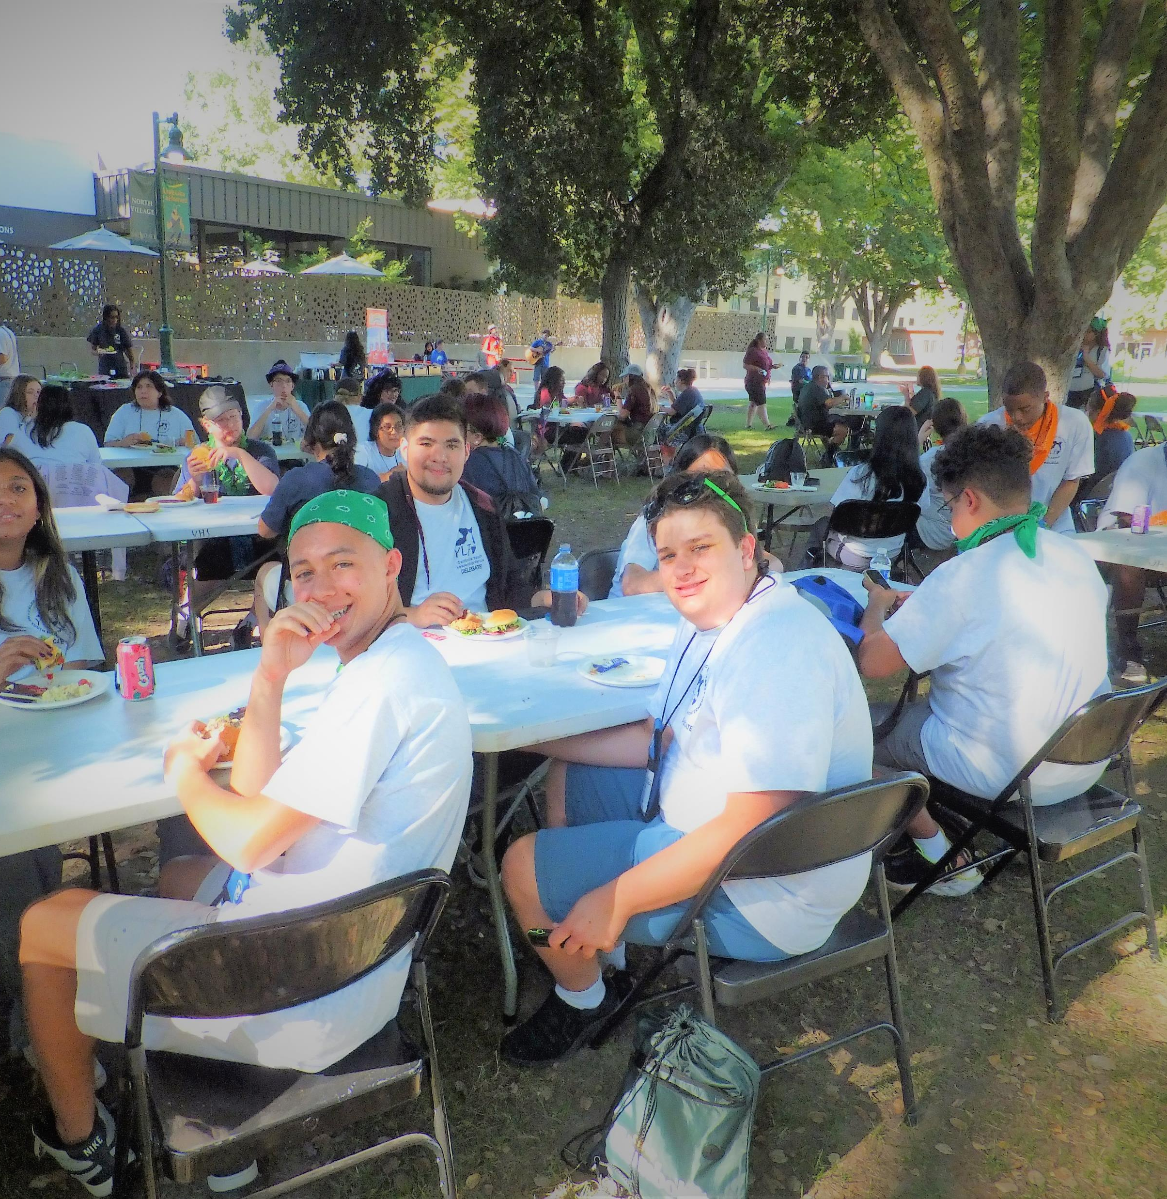
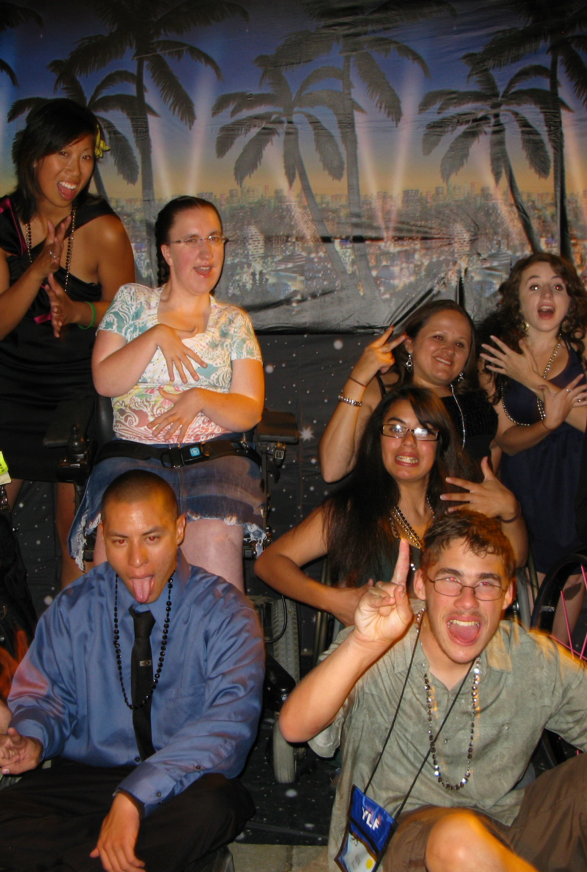
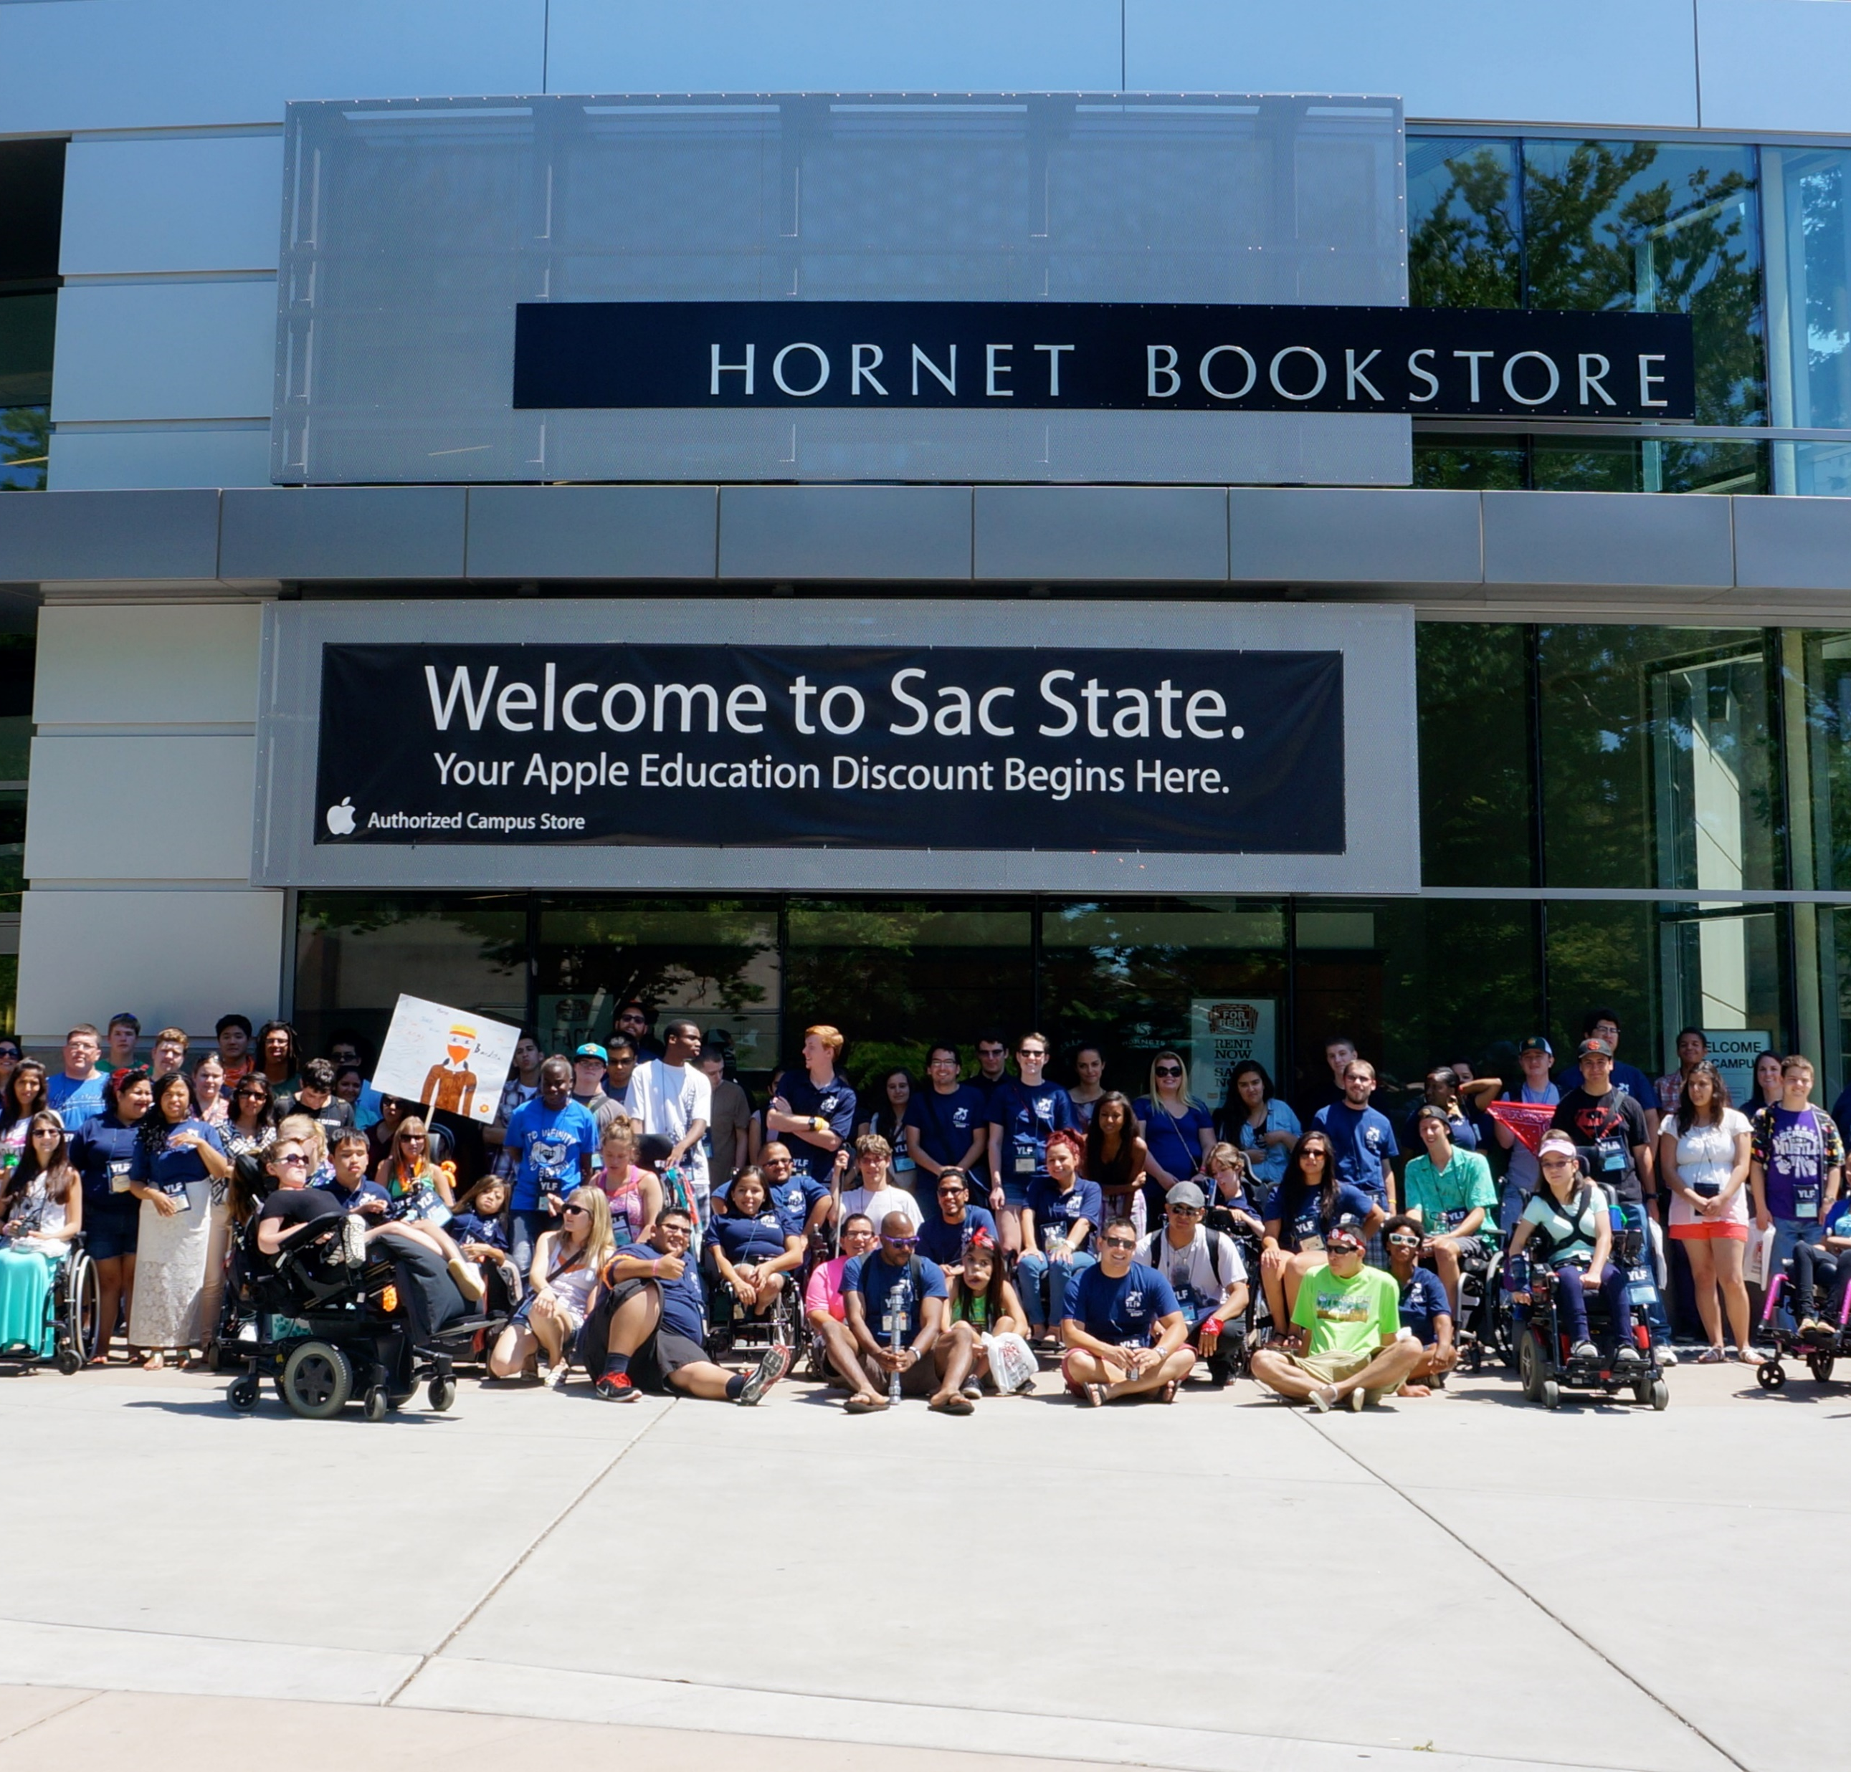
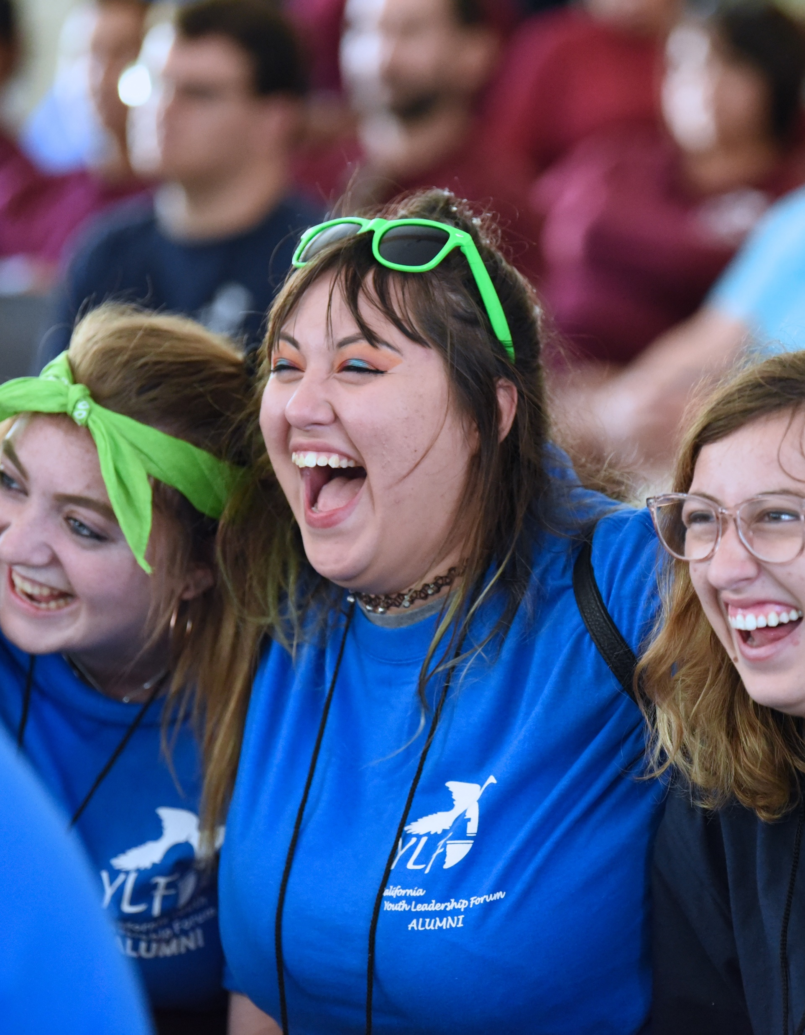
Activities during ylf
Outside of the large and small group sessions where delegates discuss varying topics, we also have social activities which encourage delegates to socialize with one another, build friendships and have fun!
Activities Include –
Movie Night
Talent Show
BBQ
Dance
College Campus Tour

Slide 7
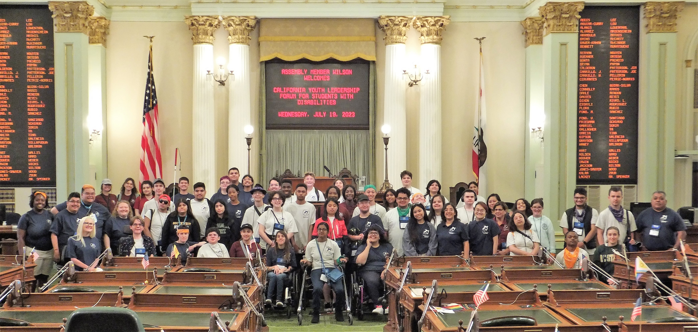
Capitol Day
YLF delegates visit the California state capitol building to further develop community engagement and self-advocacy.
YLF delegates meet with policy makers and have the chance to share their vision of the future for people with disabilities #disabledandproud

Slide 8
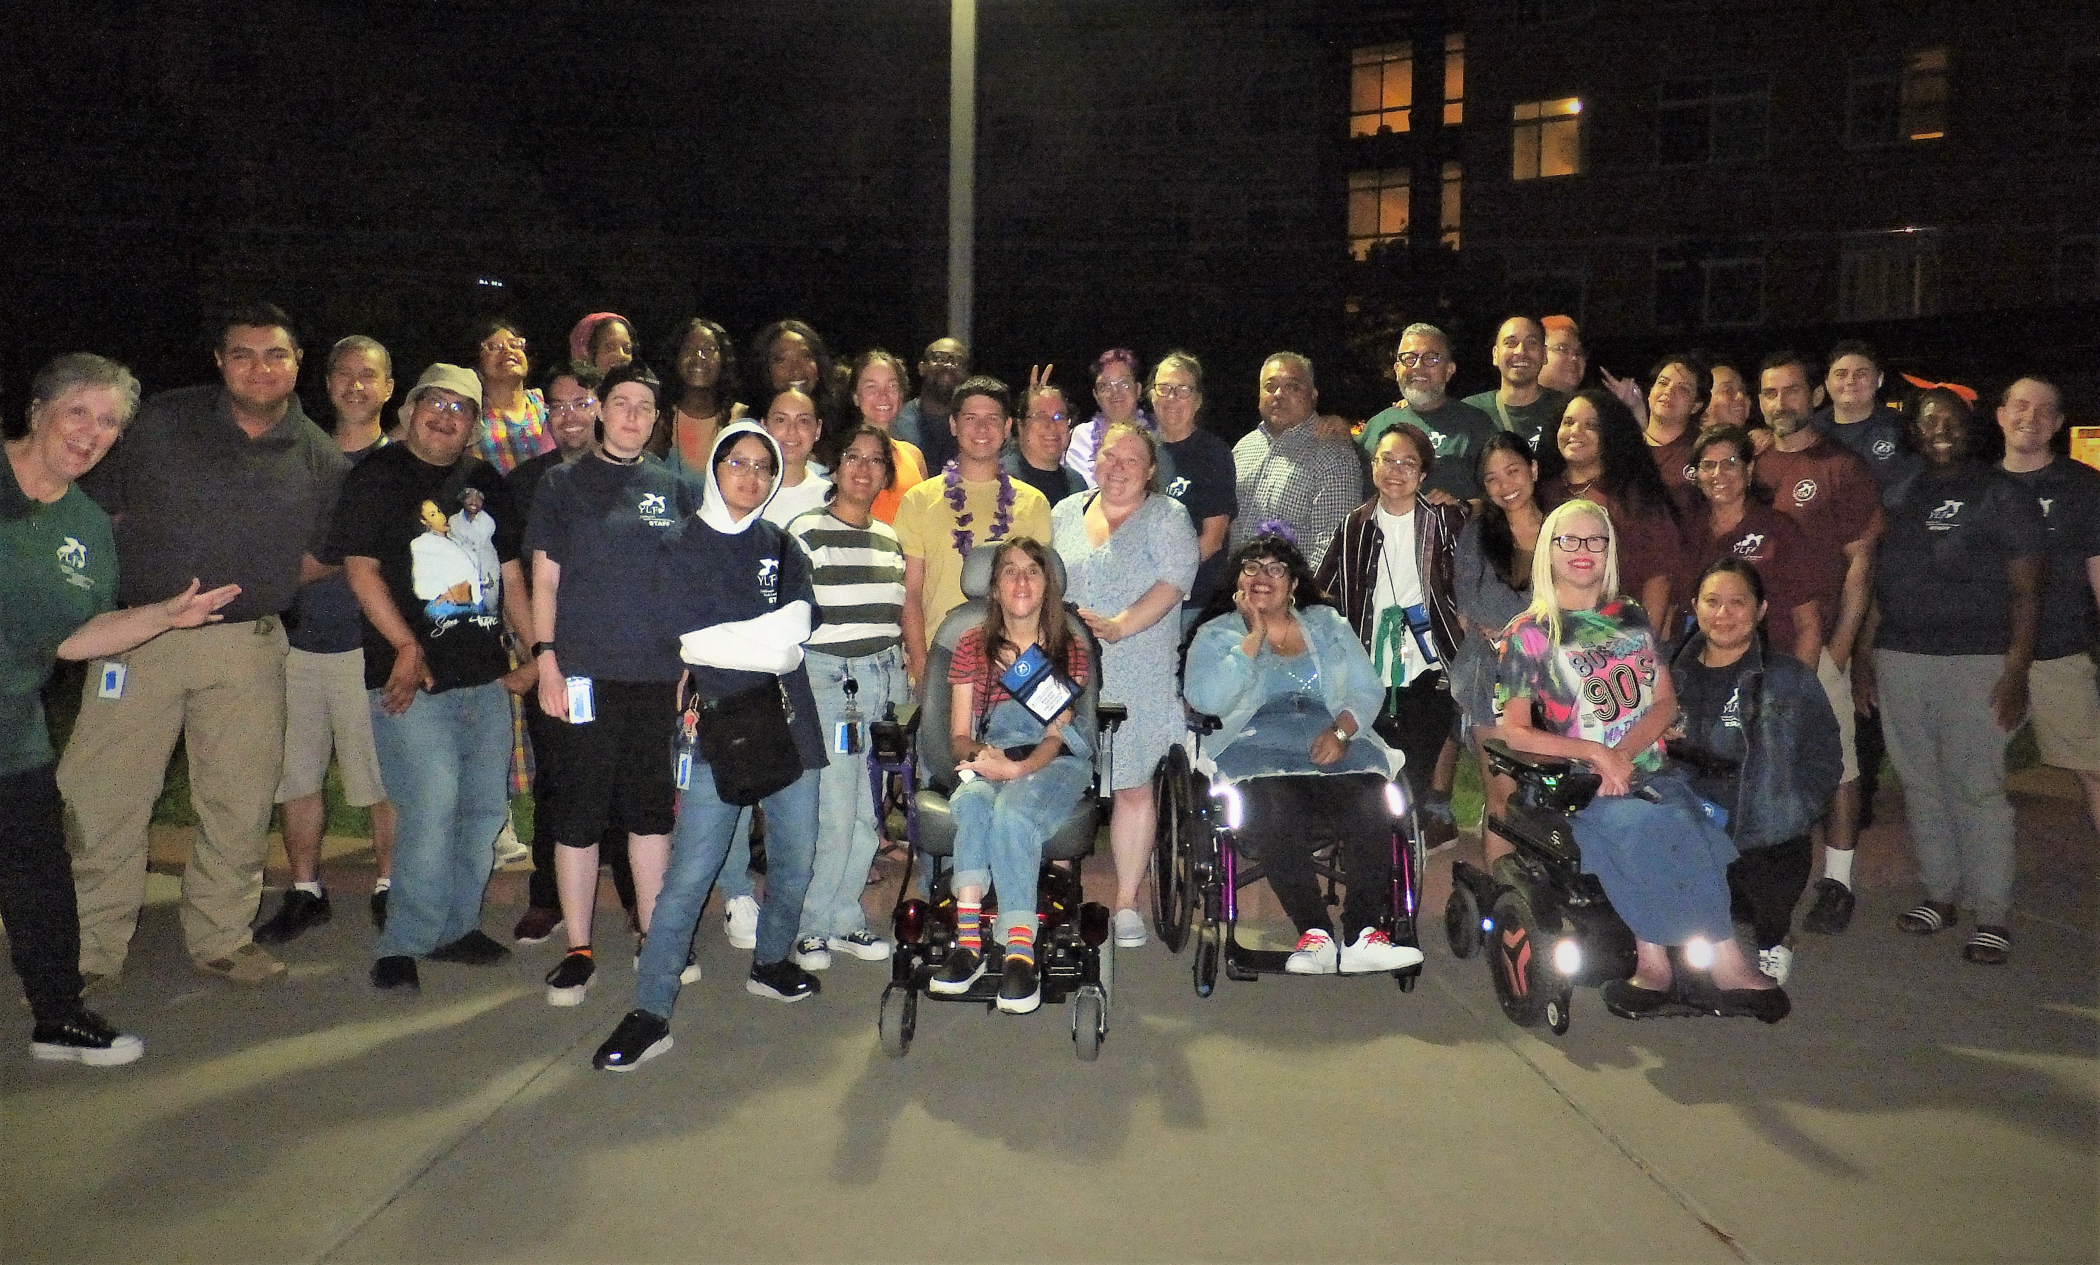
YLF is not just a weeklong experience
YLF encourages delegates to stay connected with one another and the YLF network after the weeklong event
YLF hosts monthly alumni workshops to further support youth prepare for the transition after high school and include topics related to money management, apprenticeships, work experience, navigating financial aid, self-advocacy, and career exploration
YLF encourages delegates to apply and return to YLF as volunteer alumni staff serving as counselors, peer mentors and group assistants supporting future YLF delegates
In 2021, AYLF, the national YLF network hosted it’s first AYLF event bringing together alumni from across the United States virtually on Zoom. This event featured the late Disability Rights Advocate and Activist Judy Heumann.

Slide 9
YLF is what??? Dynamite!

Slide 10
Join us for ylf 2024! Delegate applications open now! Find the application and more information on our website at www.dor.ca.gov/home/ylf

Slide 11
Contact us
For more information or additional questions:
YLF Email: ylf@dor.ca.gov
Website: www.dor.ca.gov/home/ylf
Phone: (855) 894-3436
https://www.instagram.com/calylf/
https://www.facebook.com/official.ca.ylf
https://www.youtube.com/channel/UCA6C4gU7YagNi_ROdlwGF9A

