Slide 1

TBI 101
An Introduction to Traumatic Brain Injury
Presented by
The California Traumatic Brain Injury Advisory Board
in association with
The Brain Injury Survivors Committee

Slide 2
Overview
1
2
3
Introduce Public to TBI
Increase Awareness
Provide Community Resources

Slide 3
Why is Brain Injury Awareness Important?
Major cause of death and disability
Short and long-term chronic health concerns
Frequently underdiagnosed
Growing public health concern
Over 200,000 TBI-related emergency department visits and hospitalizations each year in California

Slide 4
What Is Brain Injury?
Acquired (ABI)
Any brain injury that occurs after birth
Caused by internal trauma (non TBI) and external trauma (TBI)
Traumatic (TBI)
Occurs when an external force causes damage to the brain.
Can range from mild (like a concussion) to severe
Can affect physical, cognitive, emotional, and behavioral functions.

Slide 5
Common
Causes of ABI
Stroke
Anoxia
Brain tumor
Poisoning
Drugs

Slide 6

Brain Injury Symptoms
Brain injury symptoms can vary based on the individual and the severity of their injury.
A person may not recognize or admit they are having problems.
A person may not understand how symptoms affect their daily lives.
Brain injuries can affect multiple aspects of a person’s life.

Slide 7


Physical
Cognitive
Balance
Dizziness and Vertigo
Fatigue
Headaches
Vision
Light and Sound Sensitivity
Confusion
Easily Overwhelmed
Decision Making
Motivation and Initiative
Concentration and Memory
Difficulty Sustaining Attention

Slide 8


Emotional
Sleep
Anhedonia (apathy)
Anxiety or nervousness
Angered easily, irritable, mood swings
Sadness, depression, increased risk for suicide
Lack of motivation
Flooding (easily overwhelmed)
Social isolation, sensitive to criticism
Insomnia: Difficulty falling asleep or staying asleep
Obstructive sleep apnea
Sleeping less than usual
Sleeping more than usual
Vivid dreams or nightmares

Slide 9
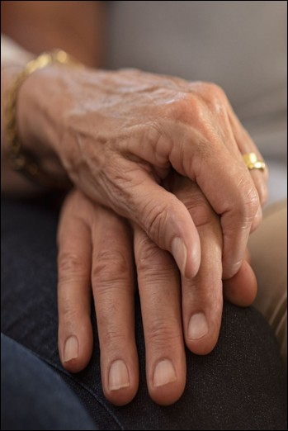
Brain Injury Survivors Speak
“The E.R. said I was ‘fine’, that I ‘just’ had a concussion and should rest for the day.
I couldn’t remember how to drive; how old my kids were or where I lived. It’s like someone had taken out a big chunk of my brain, but I knew my name and birthday and that’s all it took to decide I was ‘fine.’
That day ruined my life, and no one seemed to think it was a big deal.”
-TBI survivor

Slide 10
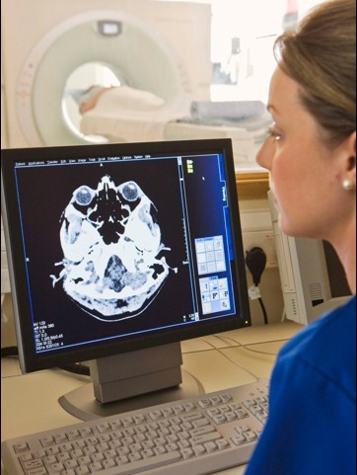
TBI Diagnosis
Diagnosis often includes:
Neurological exams
Brain imaging (CT or MRI)
Cognitive and emotional assessments
Mild TBIs may not appear on scans, so symptom tracking is critical.

Slide 11

Treatment and Recovery
Rest and gradual return to activity
Physical, occupational, and speech therapy
Cognitive rehabilitation
Counseling and emotional support
Recovery varies widely by individual

Slide 12

TBI & Substance Use: Key Facts
Many TBIs involve intoxication: Up to 24–51% of adolescents and adults were intoxicated at the time of injury.
High rates of prior substance use: 25% of people hospitalized for TBI have a history of Substance Use Disorder.
Increased risk of repeat TBI: Alcohol-related TBIs make individuals 4× more likely to sustain another TBI.
Slower recovery: Alcohol can delay healing and raise the risk of seizures.
Worsened symptoms: Alcohol and other substances can intensify problems with cognition, balance, impulsivity, and depression.

Slide 13
Intimate Partner Violence
Intimate partner violence is a common cause of TBI
Victims of partner violence are less likely to report their TBIs than people who are injured in other ways. Male victims are even less likely than women to come forward.
Survivors of TBIs caused by domestic violence are more likely to experience poorer overall health, including both physical and mental health challenges.

Slide 14
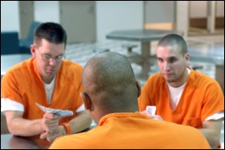
Incarceration
Research suggests almost half of people in correctional or detention facilities such as prisons and jails have a history of TBI.
In a Virginia study, more than half of children in the juvenile justice system, followed over an 18-month period, screened positive for brain injury.
People in correctional or detention facilities that have a history of TBI are much more likely than non-TBI survivors to present with the following:
-Mental health problems
-Substance use disorders
-Difficulty controlling anger
-Suicidal ideations or attempts

Slide 15
Housing Instability
California has the highest rate of homeless individuals in the nation.
70% of homeless individuals with TBI experienced their first brain injury before they became homeless.
People who experience homelessness have a much greater risk for having a prior TBI and for experiencing an additional TBI.

Slide 16
Health Disparities
People in rural areas have greater risk of dying from brain injury:
More time needed for emergency medical care to arrive and to deliver the patient to a trauma center
Less access to a Level 1 trauma center
Difficulty getting specialized care
Survivors with lower incomes or who are uninsured:
Less likely to receive treatment
Less likely to receive inpatient services and rehabilitation
More likely to die in the hospital

Slide 17

How to Support Brain Injury Survivors
Be patient and understanding
Offer help with daily tasks
Encourage rest and self-care
Avoid overstimulation
Support emotional well-being
Be mindful of differing communication styles

Slide 18

Preventing TBIs
Be patient and understanding
Offer help with daily tasks
Encourage rest and self-care
Avoid overstimulation
Support emotional well-being
Be mindful of differing communication styles

Slide 19
Key Takeaways
Recovery is unique for everyone.
Progress takes time.
Certain populations are at greater risk for TBI and poorer outcomes.
Early diagnosis and consistent care are critical

Slide 20
How the Department of Rehabilitation Serves TBI-impacted Californians
Direct Support
State-funded TBI Program Sites providing services and resources to individuals living with TBI.
Services included:
            Enhanced Information and Assistance​
            Community Navigation​
            Person Centered Case Coordination​
            Community Reintegration​
            Supported Living​
            Vocational Supportive Services​
            Public and professional education services
For information on partnering with the TBI program or become a TBI program site, please email at TBI Information email

Slide 21
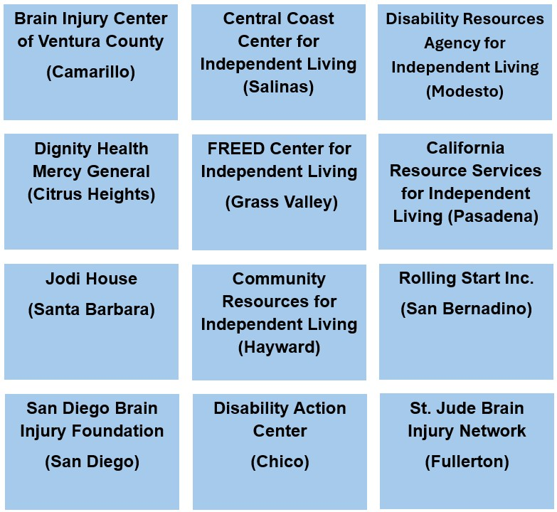
TBI Program Sites
DOR TBI Program Sites
TBI sites are subject to change.
Please confirm with the site before referring.

Slide 22
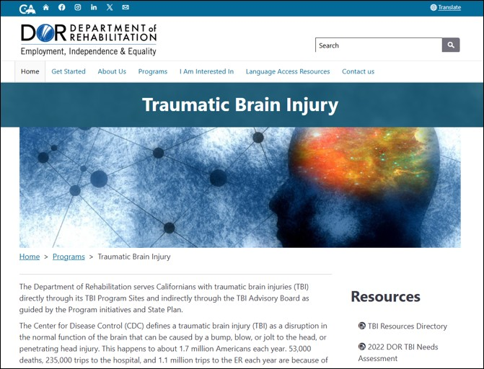
TBI Resources Directory
File available on the DOR TBI website.
Download TBI Resources Directory

Slide 23
Suggested Screening Tools for TBI
NASHIA The HELPS Brain Injury Screening Tool
Ohio State TBI Identification Method

Slide 24
References
BIAA Brain Injury Association of America
CDC: Traumatic Brain Injury & Concussion
CDC: Health Disparities in TBI
Couples’ Relationships After Traumatic Brain Injury
Social Skills After Traumatic Brain Injury

