Slide 1

TBI 101

Slide 2
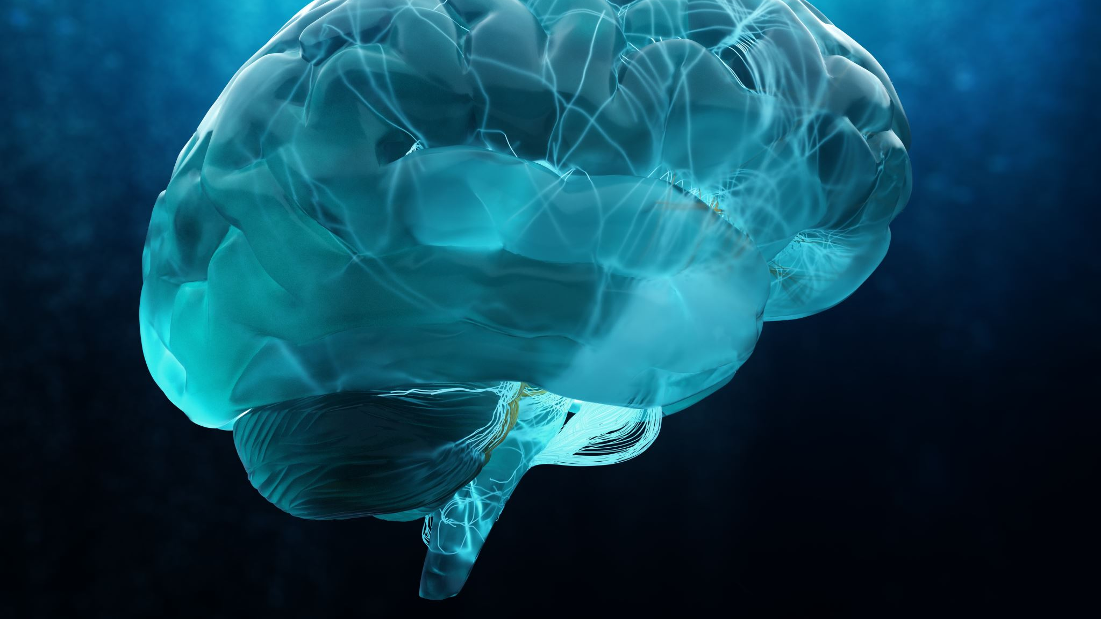
TBI 101
California
Department of Rehabilitation
Traumatic Brain Injury
Informational Slide Presentation

Slide 3

Department of Rehabilitation (DOR) and Traumatic Brain Injury
DOR serves Californians with traumatic brain injuries (TBI)
CA TBI Advisory Board advises state leadership on policies & programs
https://www.dor.ca.gov/Home/TBI
Notes:
Intro to DOR
DOR serves TBI impacted persons:
Directly through its TBI Program Sites
Indirectly through the TBI Advisory Board as guided by the Program initiatives and State Plan
Dually funded
State funded program provides grants to non-profit organizations that directly serve individuals living with TBI
Federally funded program to strengthen the system of services and supports to maximize the independence, well-being, and health of people with brain injuries, their caregivers, and families.
Subcommittees
Brain Injury Survivor Committee
Public Policy and Funding Committee
Data Analytics Committee
Education and Public Outreach Committee
TBI State Plan Committee

Slide 4
TBI 101 SLIDE PRESENTATION
OBJECTIVES:
01
02
03
Introduce people to TBI
Raise awareness!!
Introduce community resources

Slide 5
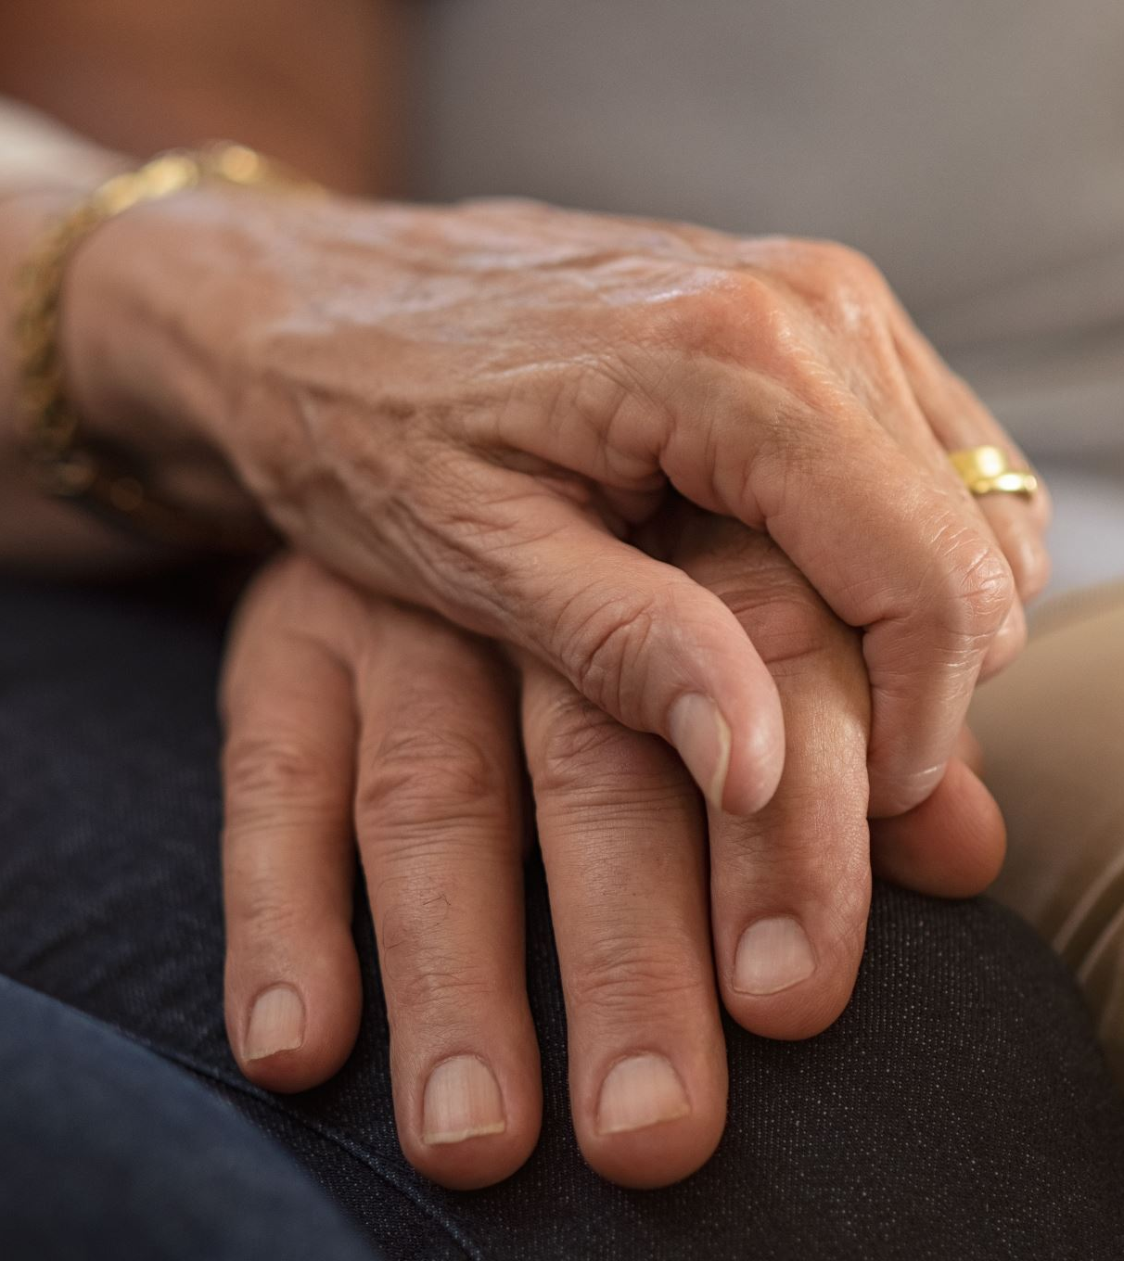
TBI Survivors Speak
“The E.R. said I was ‘fine’, that I ‘just’ had a concussion and should rest for the day.
I couldn’t remember how to drive, how old my kids were or where I lived. It’s like someone had taken out a big chunk of my brain, but I knew my name and birthday and that’s all it took to decide I was ‘fine’.
That day ruined my life, and no one seemed to think it was a big deal.”
-TBI survivor
Notes:
Survivor story and experience

Slide 6
Defining
Brain
Injuries
ACQUIRED BRAIN INJURY
(ABI)
VS.
TRAUMATIC BRAIN INJURY
(TBI)
Notes:
For more information: BIAA Brain Injury Association of America website: biausa.org
ABI is not congenital, degenerative, or induced by birth trauma. This type of brain injury occurs after birth and results in a change to the brain’s activity, affecting the physical integrity, metabolic activity, or functional ability of nerve cells in the brain. Brain injuries that occur from birth, or just before or after birth, are called congenital brain injury.
An ABI is the umbrella term for brain injuries after birth. There are two types of ABI: traumatic and non-traumatic
While we are happy to talk about ABI’s in another meeting or at the end, our focus today is on TBI’s
BIAA Brain Injury Association of America website: biausa.org

Slide 7
ACQUIRED BRAIN INJURY
(ABI)
ABI is the term for any brain injury that occurs after birth
~
ABI’s can be ‘traumatic’ (caused by an external force to the body)
or
‘non-traumatic’ from (internal causes)

Slide 8
Traumatic Brain Injury
(TBI)
A TRAUMATIC BRAIN INJURY OR TBI IS WHEN A BRAIN IS INJURED
BY AN EXTERNAL FORCE TO THE BODY
THE INJURY CAN COME FROM A DIRECT BLOW TO THE SKULL
OR
CAN RESULT FROM SOMETHING VIOLENTLY MOVING THE HEAD

Slide 9
Please consider…
Brain injuries are often experienced as EMOTIONALLY Traumatic
  traumatic brain injuries or TBI’s is the term often used for a head injury that is more long lasting or severe than a ‘concussion’
  The term ‘traumatic brain injury’ or TBI clarifies the cause of injury
  Therefore, ‘non-traumatic’ brain injuries (such as a stroke) can be
  ‘NON-TRAUMATIC’ IN ORIGIN
  YET can feel Emotionally traumatic

Slide 10

Why is awareness of TBI Important?
Short- and/or long-term health concerns
Major cause of death and disability
Silent epidemic
Growing public health concern
Over 200,000 TBI-related Emergency Dept visits & hospitalizations each year in CA
Functional impact
Notes:
Pare down stats
Short term health concerns- headaches, confusion, memory problems, dizziness, nausea, vomiting, change in mood, light or sound sensitivity
Long term health concerns – behavioral changes, hearing problems, seizures, neurodegenerative diseases. More severe injuries result in more disability.
Silent Epidemic – outwardly most TBI survivors look healthy, the brain doesn’t show up like a broken arm or something else that is visible, so it is often not diagnosed
Functional impact – coordination, balance, weakness, problem solving, memory
National Statistics: Approximately 2.8 million TBI-related emergency department visits, hospitalizations, and deaths in the U.S. annually.
California Statistics: Over 200,000 TBI-related emergency department visits and hospitalizations each year in California
Age Distribution:
Children (0-14 years): Approximately 20% of TBI cases.
Adolescents and Young Adults (15-24 years): Around 15% of cases, often due to sports injuries and motor vehicle accidents.
Adults (25-64 years): Approximately 40% of cases, with a significant number resulting from workplace injuries and motor vehicle accidents.
Older Adults (65+ years): About 25% of cases, with falls being the leading cause.

Slide 11


Common Causes of TBI
MOST NON-FATAL TBI CAUSES:
  Assault
  Falls
  Military combat, such as blast injuries
  Motor vehicle accidents: direct impact or indirect or ‘contra-coup’ injury
  Struck by an object, such as during sports
  Non-contact injuries, such as being shaken (partner violence or child abuse – ‘shaken baby syndrome’).
Notes:
Contra-coup injuries are when the brain moves violently, back and forth in the skull, causing bruising, bleeding or microscopic tears in the brain fibers.
Shaken-baby syndrome is the term used the for the brain damage caused when babies are violently shaken.
‘Shearing’ or microscopic tearing of brain tissue can lead to brain trauma without anything ever hitting the head.

Slide 12
Who is at risk?
ANYONE IS AT RISK FOR TBI, BUT SOME GROUPS OF PEOPLE ARE AT GREATER RISK:
  Children
  Military service members and veterans
  Older adults, especially those 75 years old and older
  People in correctional or detention facilities
  People living in rural areas
  People who experience homelessness
  People of racial, ethnic and gender-based minority groups
  Individuals living with family violence or intimate partner violence
Notes:
https://www.cdc.gov/traumatic-brain-injury/health-equity/index.html

Slide 13

Symptoms of TBI
Symptoms of TBI can vary based on the individual and the severity of their injury
A person may not recognize or admit they are having problems
A person may not understand how symptoms affect their daily lives:
Cognitive
Emotional
Physical
Sleep
Notes:
Infographic of symptoms
https://www.cdc.gov/traumatic-brain-injury/signs-symptoms/index.html

Slide 14
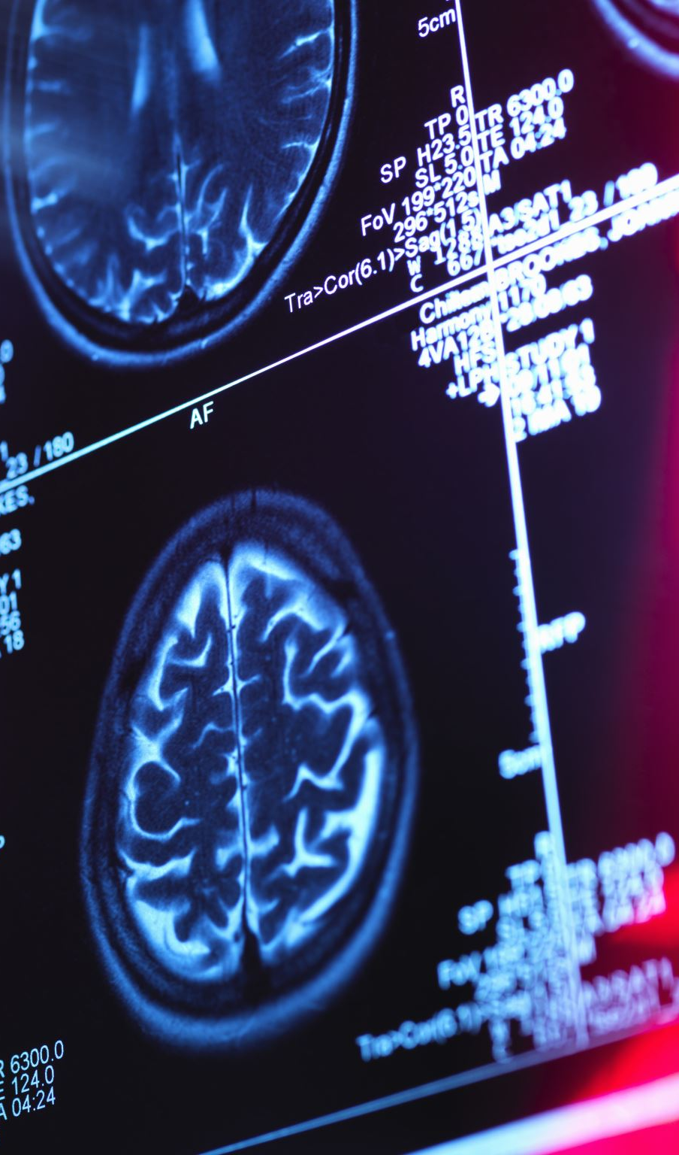
What to look for…
Physical Symptoms
Balance problems
Dizziness
Fatigue
Headaches
Sensitivity to light and sound
Vertigo
Vision problems
Notes:
Physical Symptoms:, gait issues, swallowing challenges, migraine, vestibular weaknesses,
vision changes, dysarthria (slurred speech)

Slide 15
What to look for…
Cognitive Symptoms
Attention difficulties
Confusion
Difficulty concentrating
Difficulty following directions
Feeling foggy or slowed down
Flooding: feeling easily overwhelmed
Short or long-term memory problems
Trouble making decisions
Trouble with motivation and initiative

Slide 16
What to look for…
Emotional Symptoms
Agitation, apathy, anxiety or nervousness
Anhedonia
Angered easily, irritable, mood swings
Emotional dysregulation (highly emotional)
Sadness, depression, increased risk for suicide
Social isolation, sensitive to criticism
Lack of motivation, easily discouraged
PTSD symptoms: Easily ‘triggered’
Notes:
Anhedonia (inability to experience pleasure, reduced motivation, loss of anticipation for future activities)

Slide 17

What to look for…
Sleep Symptoms
Insomnia: Difficulty falling asleep or staying asleep
Obstructive sleep apnea
Sleeping less than usual
Sleeping more than usual
Vivid Dreams or nightmares

Slide 18
TBI’s Impact on
Relationships and
Social Skills
Changes responsibilities and roles in a relationship
Can affect communication and expression
Can impact social skills
Notes:
Communication Changes:
Losing focus and maintaining a conversation
Forgetting what someone has said
Misunderstanding expressions and cues
Difficulty getting-along with others
Loss of filter
Changes responsibilities and roles in a relationship:
Driving
Childcare
Income
Parenting
What if both parents or partners are injured?
Can impact social skills:
Communication
Memory challenges
Impulsivity
Heightened emotional reactivity
Aggression/anger
https://msktc.org/tbi/factsheets/relationships-after-traumatic-brain-injury
https://msktc.org/tbi/factsheets/social-skills-after-traumatic-brain-injury

Slide 19
Substance Use
AND
SUBSTANCE abuse
Substance use and abuse
increases the likelihood
(risk factor) for TBI
  Up to one out of every two adolescents and adults sustaining a TBI were intoxicated when the injury occurred (24-51%)
  One in four people hospitalized for TBI have a history of substance use disorders (25%)
  People with alcohol-related TBI are four times more likely to experience another TBI
  Alcohol can slow recovery and increase risk of seizures
  Alcohol and other substances can worsen the symptoms of TBI increasing challenges with cognition, balance, impulsivity, and depression
Notes:
Corrigan, J. D., Bogner, J., & Holloman, C. (2012). Lifetime history of traumatic brain injury among persons with substance use disorders. Brain Injury, 26(2), 139–150. https://doi.org/10.3109/02699052.2 011.648705
Corrigan, J. & Mysiw,M. (2013). Substance Misuse Among Persons with Traumatic Brain Injury, in Brain Injury Medicine: Principles and Practice, Ed. N. Zasler,D. Katz,.D. Arcubegas. R. Zafonte, New York: Demos Medical.
Cuthbert, J. P., Harrison-Felix, C., Corrigan, J. D., Kreider, S., Bell, J. M., Coronado, V. G., & Whiteneck, G. G. (2015). Epidemiology of adults receiving acute inpatient rehabilitation for a primary diagnosis of traumatic brain injury in the United States. The Journal of Head Trauma Rehabilitation, 30(2), 122–135. https://doi.org/10.1097/HTR.0000000000000012
Parry-Jones, B. L., Vaughan, F. L., & Miles Cox, W. (2006). Traumatic brain injury and substance misuse: a systematic review of prevalence and outcomes research (1994-2004). Neuropsychological Rehabilitation, 16(5), 537–560. htt
ps://doi.org/10.1080/09602010500231875

Slide 20
TBI and
Intimate Partner Violence
Women experience TBIs during partner violence 11–12 times more often than military personnel and athletes combined, experience a TBI
Victims of partner violence are less likely to report their abuse than TBIs from other causes, with male victims even less likely than women, to come forward
Survivors of TBI due to domestic violence are more likely to have overall poor health outcomes, including both physical and mental health
Survivors of partner violence TBI are frequently diagnosed with PTSD, insomnia, and depression
Notes:
Domestic violence can lead to TBI through aggressive shaking, strangulation, a blow to the head (with a fist and/or heavy object), and falling/being thrown to the floor
https://www.cdc.gov/traumatic-brain-injury/health-equity/index.html
Costello K, Greenwald BD. Update on Domestic Violence and Traumatic Brain Injury: A Narrative Review. Brain Sci. 2022 Jan 17;12(1):122. doi: 10.3390/brainsci12010122. PMID: 35053865; PMCID: PMC8773525.
Lifshitz, J.; Crabtree-Nelson, S.; Kozlowski, D.A. Traumatic Brain Injury in Victims of Domestic Violence. J. Aggress. Maltreatment Trauma 2019, 28, 655–659.
Ralston, B.; Rable, J.; Larson, T.; Handmaker, H.; Lifshitz, J. Forensic Nursing Examination to Screen for Traumatic Brain Injury following Intimate Partner Violence. J. Aggress. Maltreatment Trauma 2019, 28, 732–743.

Slide 21
TBI and
Housing Instability
California has the highest rate of unsheltered homeless individuals in the nation
70% of homeless individuals with TBI experienced their first brain injury before they became homeless
People who experience homelessness have a much greater risk for having a prior TBI and for experiencing an additional TBI
Notes:
2-4 x more likely to have a history of any type of TBI
Up to 10x more likely to have a history of moderate or severe TBI
Prevalence of 53.1% for any severity of TBI
Prevalence of 22.5% for moderate or severe TBI
Stubbs JL, Thornton AE, Sevick JM, Silverberg ND, Barr AM, Honer WG, Panenka WJ. Traumatic brain injury in homeless and marginally housed individuals: a systematic review and meta-analysis. Lancet Public Health. 2020 Jan;5(1):e19-e32. doi: 10.1016/S2468-2667(19)30188-4. Epub 2019 Dec 2. Erratum in: Lancet Public Health. 2020 Jan;5(1):e18. doi: 10.1016/S2468-2667(19)30257-9. PMID: 31806487.
Hwang et al. The effect of traumatic brain injury on the health of homeless people. CMAJ 2008 Oct 7; 179(8): 779-784.

Slide 22
TBI and
Incarceration
Research suggests almost half of people in correctional or detention facilities such as prisons and jails have a history of TBI
In a Virginia study, more than half of children in the juvenile justice system, followed over an 18-month period, screened positive for brain injury
People in correctional or detention facilities that have a history of TBI are much more likely (than non-TBI survivors) to present with the following:
Mental health problems
Substance use disorders
Difficulty controlling anger
Suicidal thoughts and or attempts
Notes:
A close relationship exists between TBI and incarceration. People in correctional or detention facilities with TBI-related problems may not be screened for a TBI or may face challenges with getting TBI-related care
Hunter S, Kois L, Peck A, Elbogen E, LaDuke C. (2023). The prevalence of traumatic brain injury (TBI) among people impacted by the criminal legal system: An updated meta-analysis and subgroup analyses. Law and Human Behavior, 47(5), 539–565.
Virginia study: Kreutzer et al 2012

Slide 23
TBI and
Health Disparities
Racial and ethnic minority groups, particularly non-Hispanic black and Hispanic patients, are less likely to receive follow-up care and rehabilitation following a TBI, compared to non-Hispanic white patients
Racial and ethnic minorities are also more likely to have poor psychosocial, functional, and employment-related outcomes after sustaining a TBI than non-Hispanic white individuals.

Slide 24
TBI and
MORE
Health Disparities
People in rural areas have greater risk of dying from TBI:
  More time needed for emergency medical care to arrive and to deliver the patient to a trauma center
  Less access to a Level 1 trauma centers
  Difficulty getting specialized TBI care
TBI survivors with lower incomes or who are uninsured:
  Less likely to receive TBI treatments
  Less likely to receive inpatient services and rehabilitation
  More likely to die in the hospital

Slide 25
TBI and
Native Americans
American Indian/Alaska Native children and adults have higher rates of TBI-related hospitalizations and deaths than other racial or ethnic groups
Factors that contribute to this disparity include higher rates of motor vehicle crashes, substance use, and suicide, as well as difficulties in accessing appropriate healthcare

Slide 26
Screening for TBI: Considerations…
Consider:
Your clients may not be aware they have had a TBI…
Consider:
When should screening occur?
Consider:
Who should be screened?
Notes:
TBI might not be a visible disorder
Some might not know they have had a TBI
Clients as well as staff may underestimate the impact of their TBI

Slide 27
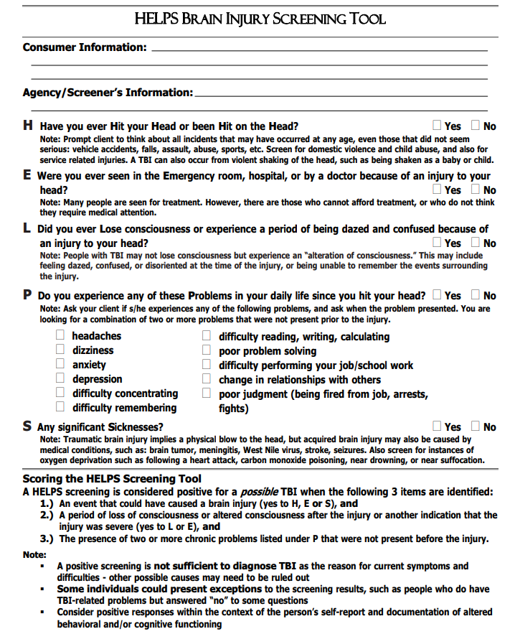
Suggested Screening
Tools
The ‘HELPS’ Brain Injury
Screening tool
  NASHIA
  Https://www.Nashia.Org/resourceslist/cdxvc5lcq3q3ycesazm0wfyg9umxye
Notes:
HELPS screening tool
NASHIA is the national Association of State Head Injury Administrators

Slide 28
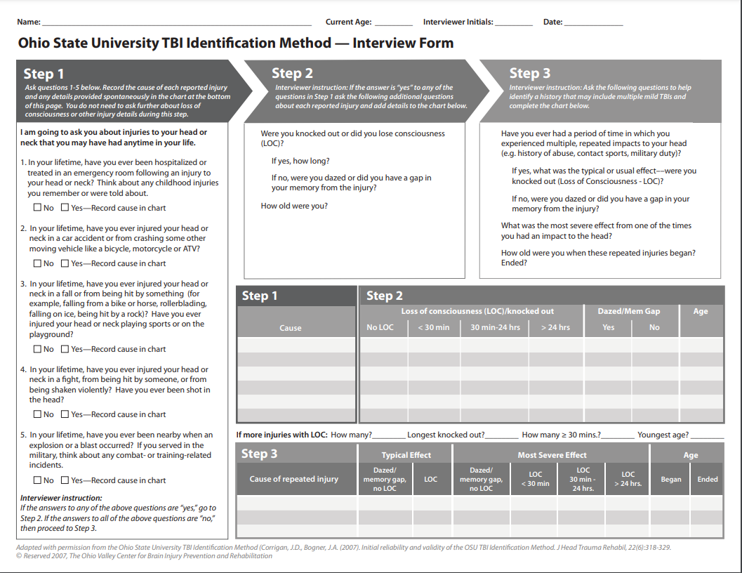
Another screening example:
Ohio State TBI-ID
Chronic brain injury - OSU TBI-ID overview | discovery themes, the ohio state university
Notes:
The Ohio State TBI-ID is a validated instrument that can be easily used and is open for download. The OSU website has step by step video instructions on how to use the tool
Corrigan JD, Bogner J. Initial reliability and validity of the Ohio State University TBI Identification Method. J Head Trauma Rehabil. 2007 Nov-Dec;22(6):318-29. doi: 10.1097/01.HTR.0000300227.67748.77. PMID: 18025964.

Slide 29
How to interact with people with TBI
Many people with TBI may have a good physical recovery, so they may ‘look okay’, but they may…
  Have difficulty regulating their behavior or responding skillfully in certain situations
  Not recognize, nor understand the effects of their behavior on others
  Not be able to focus on, or attend to the current situation fully
  Have difficulty following multi-step commands
  Find noise and lots of information, overstimulating
  Be easily overwhelmed and emotional
Stress can exacerbate the emotional and cognitive difficulties of TBI

Slide 30

Communication strategies
  For acute injuries:
  Speak calmly and naturally
  Confirm understanding verbally, then follow up with written directives and information
  Encourage loved ones to help the TBI patient with following directives and their aftercare plan.
  Use direct, short phrases
      Allow time to process what you say
      Allow time for a response
      If confusion occurs try re-phrasing your statement, breaking it down into smaller parts
      Alert the person to changes in topic. Allow time for questions

Slide 31
Communication strategies
Continued
Remember:
People who have just suffered a brain injury
  May be confused or scared
  May not retain what you tell them
  May have worsening symptoms once they are home
  May need help following directives once discharged
TBIs do not decrease a person’s intelligence but can impact memory, language skills, motor skills, and information processing time.

Slide 32
Management Options for TBI Recovery
Rehabilitation
  Physical Therapy
  Occupational Therapy
  Speech Therapy
Vocational/Occupational support
  Cognitive re-training
Neuropsychology
Mental Health and Addiction support
Social support groups
Medical Care
    Primary care
    Physiatrist
    Neurologist
    Neurosurgeon
    ENT-Vestibular
    Psychiatrist
    Vision Evaluation & Rehabilitation

Slide 33
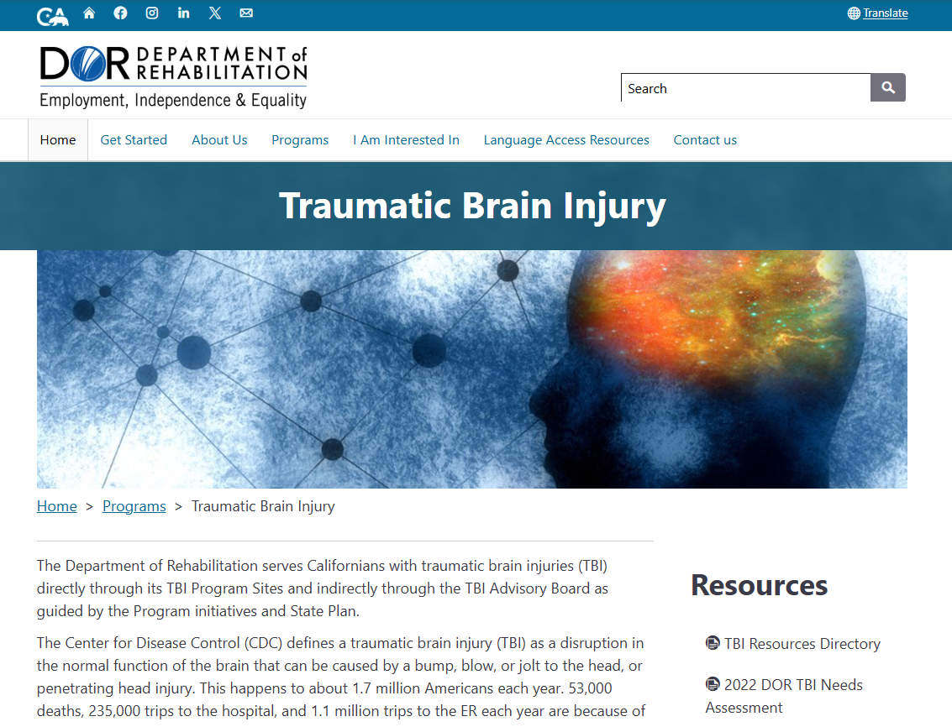
TBI Resources Directory
File available on the DOR TBI website
Download TBI Resources Directory

Slide 34
California Association for Traumatic Brain Injury (CATBI)
The California Association for Traumatic Brain Injury (CATBI) is a voluntary association of state funded TBI program sites.
The sites have applied for and been awarded state funds to provide several core services for TBI survivors/family members/caregivers and their local communities.
The department of rehabilitation evaluates the site applications, distributes funds, and provides general oversight.
Each site provides their interpretation of the universal core services, as described in their grant application.
The core services are:
      Supported living
      Community reintegration
      Vocational supportive
      Community navigation (more hands on)
      Enhanced information and assistance
      Public and professional education

Slide 35
CATBI continued
The purpose of CATBI is to work together to provide services, and advocate for, TBI survivors and their families/caregivers.
The website for CATBI: https://catbi.info/
In the past CATBI sites have worked together on related legislation, establishing the website, and data collection (even before the TBI advisory board).
  CATBI mission:
    Partnering to restore identity and independence after brain injury.
  CATBI vision:
    A future where individuals with brain injury reach their full potential.

Slide 36
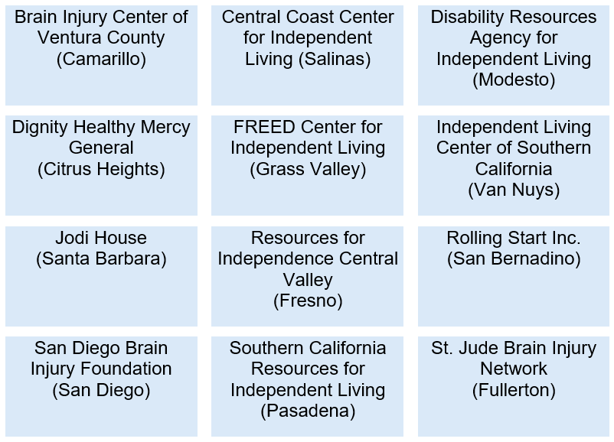
Current
California Association for
Traumatic Brain Injury
(CATBI) sites
(*as of July 2025)
https://www.dor.ca.gov/Home/TBIProgramSites
* This information is subject to change over time. Please confirm accuracy/availability with the site before referring.
Notes:
Pending list as RFA is currently out

Slide 37


A Case STUDY Discussion...
Here is where your agency can discuss how to apply the information on these slides to your clients/patients and develop a plan for helping TBI impacted individuals in your care.

Slide 38
Conclusion
TBI affects each person differently
Certain populations are at greater risk for TBI and poorer outcomes
TBI screening is essential!

Slide 39
References
BIAA Brain Injury Association of America website: biausa.org
CDC: Traumatic brain injury & concussion. Https://www.Cdc.Gov/traumatic-brain-injury/index.Html
CDC: Health Disparities in TBI. Https://www.Cdc.Gov/traumatic-brain-injury/health-equity/index.Html
Couples’ Relationships After Traumatic Brain Injury, 2012. Godwin E., Kreutzer J. and Kolakowsky-Hayner S., In collaboration with the Model Systems Knowledge Translation Center. Https://msktc.Org/tbi/factsheets/relationships-after-traumatic-brain-injury
Social Skills After Traumatic Brain Injury. Hawley L., Newman J., Neumann D., and O’Neil-Pirozzi T., In Collaboration With The Model Systems Knowledge Translation Center, 2019. Https://msktc.Org/tbi/factsheets/social-skills-after-traumatic-brain-injury

