Slide 1
An Overview of Trends in California’s Economy
Brandon Hooker, Economist
EDD-Labor Market Information Division

Slide 2
California: Current Workforce Trends

Slide 3
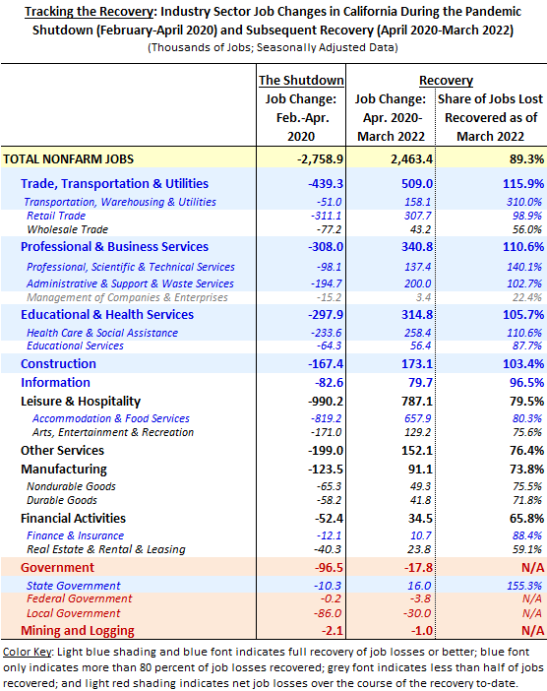
Tracking California’s Industry Recovery Construction has now fully recovered its pandemic job losses. (Information and retail trade are 2,900 and 3,400 jobs shy of full recovery, respectively.)

Slide 4
California: Economic Trends for Persons With Disabilities

Slide 5
PWD Civilian Labor Force: Type of Disability
Civilian Labor Force
People ages 16 years and older and classified as employed or unemployed.

Slide 6
PWD Long-Term Unemployed Trends
Long-Term Unemployed
Individuals who, at the time of the Census Bureau’s Current Population Survey (CPS) interview, had been jobless for 27 weeks or more.

Slide 7
PWD: Discouraged Worker Trends
Discouraged Workers
People marginally attached to the labor force who are not currently looking for work specifically because they believe that no jobs are available for them.

Slide 8
PWD in the Workforce: Industries

Slide 9
PWD in the Workforce: Occupations

Slide 10
EDD – Equal Opportunity

