Slide 1
Introduction to Aging & Disability Resource Connection
Presented by: Wilson Tam & Alexandria Griffith
California Department of Aging
March 2022

Slide 2
ADRC in a Nutshell
No Wrong Door vision
Benefits of ADRC partnerships
Linkage between ADRC and Assistive Technology

Slide 3
Navigating California’s Long-Term Services and Supports (LTSS)
Trying to navigate through the bewildering and fragmented maze of long-term services and supports (LTSS) presents a daunting task for many individuals and their families.

Slide 4
LTSS – User Perspective

Slide 5
LTSS in California

Slide 6
Real Life Challenges…
“My husband experienced a medical crisis and was in the hospital, and then in skilled nursing for a month. While this was happening, our landlord informed us they were being forced to sell and that we must move out in 30 days. But we could stay at a nearby apartment for 60 days.
I have been providing care for my husband and assisting him with the majority of ADLs every day since he was released from the SNF.
I was unable to return to work in real estate this past winter because my husband required care and assistance. We have approximately $10K in credit card debt since we have been forced to use credit to cover our medical and living costs.”
– Marin County ADRC Consumer

Slide 7
No Wrong Door (NWD) System
Aims to minimize confusion by streamlining access to LTSS through a single reliable source.
Is a highly integrated network of various community-based organizations and extended partners.
People of all ages, incomes, and disabilities receive access to the same information regardless of which partner “door” they enter.

Slide 8
NWD System in California

Slide 9
NWD System in Action

Slide 10
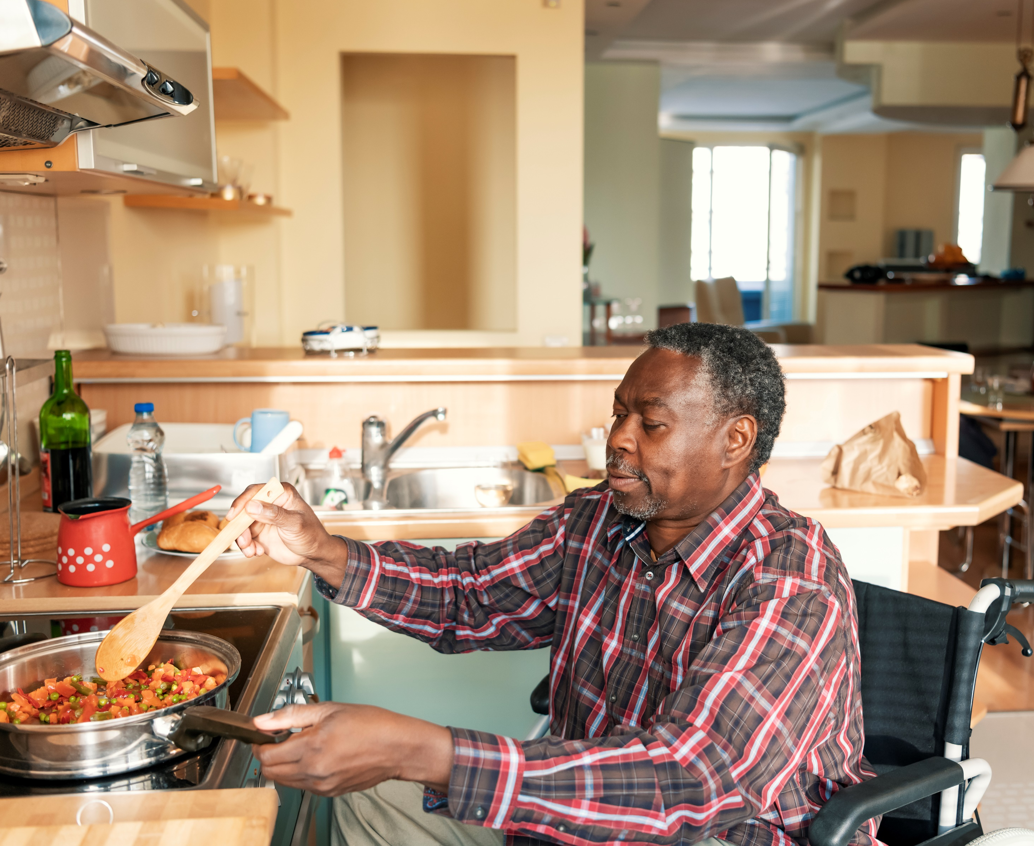
Person-Centered Practices
Helps a person navigate available LTSS systems to promote personal choices and self-determination.
Uses warm hand-offs to provides a person with information and available resources to make informed choices.
Develops culturally competent care plans.
Streamlines access to preferred public and private funded LTSS.
Builds a dynamic relationship to support a person’s transitions.
Focuses on the person. The goal is to support their decisions about where and how they wish to live.

Slide 11
Local “Core” Partners
Area Agency on Aging (AAA)
Independent Living Center (ILC)

Slide 12
Local “Extended” Partners
2-1-1, Information & Assistance Centers
Adult Protective Services (APS)
Assistive Technology (AT) Programs
Caregiver Resource Centers
Community-Based Adult Services (CBAS)
County Mental Health
Government Agencies (Public Health, Social Services, etc.)
Food Pantries
Health Insurance Counseling and Advocacy Program (HICAP)
Home Health Agencies
Hospitals
Housing Providers
In-Home Supportive Services (IHSS)
Managed Care Organizations
Medi-Cal County Eligibility Office
Medi-Cal Providers
Multipurpose Senior Services Program (MSSP)
Nursing Facilities
Ombudsman
Private Pay Organizations and Businesses
Program of All-Inclusive Care for the Elderly (PACE)
Regional Centers
Senior Centers
Transportation Providers
Veteran Services
And many more!

Slide 13
Federal Partners
Administration for Community Living (ACL)
Centers for Medicare and Medicaid Services (CMS)
Veterans Health Administration

Slide 14
State Partners
California Commission on Aging
Department of Aging
Department of Developmental Services
Department of Health Care Services
Department of Public Health
Department of Rehabilitation
Department of Social Services
Department of Veteran Affairs
State Council on Developmental Disabilities
State Independent Living Council
And more to come!

Slide 15
Key Principles of ADRC
One-Stop Coordinated System
Single Standard Process
Objective and Neutral
Person-Centered
Seamless & Person Friendly
Streamlined Access to Public & Private Programs

Slide 16
ADRC and Assistive Technology
ADRC core and extended partners are a convenient point-of-entry for older adults and people with disabilities who may be in need of assistive technology (AT).
There’s likely a higher need for AT but the public is unaware of what services are available and how to access them.

Slide 17
ADRC and Assistive Technology continued
ADRCs are optimally positioned to bring education and awareness to both consumers and their partners about the availability of AT services and programs.
AT services and resources (e.g., wheelchairs, glasses, hearing aids, screen readers, speech-generating devices, etc.) support an individual’s choice to maintain independence in the community.
AT programs and providers are a natural extended partner!

Slide 18
Revisiting Real Life Challenges…
“My husband experienced a medical crisis and was in the hospital, and then in skilled nursing for a month. While this was happening, our landlord informed us they were being forced to sell and that we must move out in 30 days. But we could stay at a nearby apartment for 60 days.
I have been providing care for my husband and assisting him with the majority of ADLs every day since he was released from the SNF.
I was unable to return to work in real estate this past winter because my husband required care and assistance. We have approximately $10K in credit card debt since we have been forced to use credit to cover our medical and living costs.”
– Marin County ADRC Consumer

Slide 19
Real Life Solutions…
“I called Info line. She connected me with the ADRC program. Once I was an ADRC client, I got assistance applying for SSI. The service coordinator got my husband and I signed up for CalFresh and helped me become my husband’s IHSS provider, which has been a lifesaver. We wouldn’t have known what IHSS even was otherwise. She also helped us find temporary housing.”
– Marin County ADRC Consumer

Slide 20
That’s it in a Nutshell!
For more information, please contact the ADRC Bureau!
Website: aging.ca.gov
Email: ADRC@aging.ca.gov

